Slide 1
CCOC Session II FCCC Fall Conference October 13, 2021

Slide 2
MODERATOR & PANELISTS
Moderator
Marleni Bruner, CCOC Senior Budget Manager
Panelists
Tony Landry, Seminole County
John Anderson, Okaloosa County
Janet Cantees, Sarasota County
Clerk Chorvat, Hernando County

Slide 3
Marleni Bruner CCOC Senior Budget Manager

Slide 4
COST SAVINGS & EFFICIENCIES
Cost savings is the benefit realized from actions that reduce an organization's overall spending on assets that directly impact its bottom line.
Cost efficiency is the ability to decrease costs and increase the bottom line by making processes more efficient

Slide 5
Productivity - Seminole
Grant Maloy – Clerk of the Circuit Court and Comptroller

Slide 6
2017
Grant Maloy
Takes the office of Clerk of the Circuit Court and Comptroller
for Seminole County

Slide 7
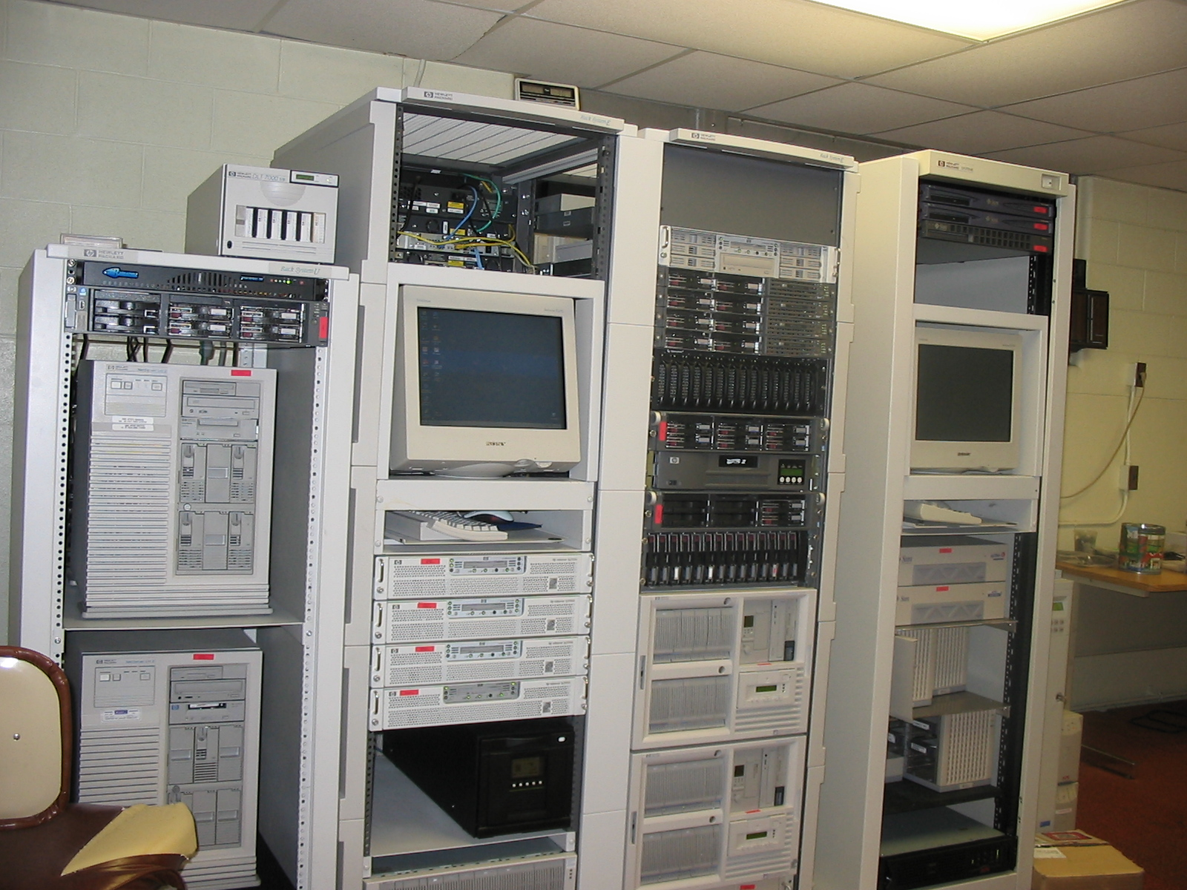
2017
In The Beginning…
15+ year old servers
40+ hours to backup to tape
840+ hours time to restore from tape
Ancient software and Operating Systems
Java 1.6 (1999)
Windows Server 2000 domain
Inappropriate use of hardware
Consumer 4-port switches used for core network switches
Firewalls out of maintenance
No Internet email or access for most employees
Paper files for everything

Slide 8
2017
The year of IT infrastructure modernization…

Slide 9
2017
February – A second monitor is added to most employee workstations
A second monitor can boost productivity for computer centric tasks by 20% - 30%
March – Credit cards are accepted as a form of payment, decreasing the wait time for customer service and increasing customer service efficiency
April – Keyboards are upgraded to models that promote a 10% - 20% increase in typing speed over standard keyboards that typically come packaged with PCs
May – Internet speed was increased from 1.54 Mb (legacy T1) to 30Mb
Staff was given Internet access allowing easier access to research and reference material, increasing productivity
Staff was given access to send and receive email over the Internet, increasing productivity through better access to communications tools
June – Wide Area Network speed was increased from 10Mb to 100Mb increasing productivity by decreasing network lag for business applications like the Case Maintenance System
July – 20 year old servers were virtualized into a modern server/SAN environment, increasing up-time and performance, which increased productivity
August – Court Records were placed online, decreasing phone calls about records, and increasing staff productivity

Slide 10
2017 (continued)
September – Wide Area Network speeds upgraded to 20Gb in a partnership with BCC IT, eliminating server and application lag over the network and increasing productivity
October – Increased Internet bandwidth to 60Mb, allowing virtual meetings, increasing online records search performance and increasing productivity
November – Replaced legacy PCs, increasing up-time and performance which resulted in increased productivity
December – Replaced legacy document scanners, increasing scanning productivity by 50%
We started with the lowest of the low hanging fruit…

Slide 11
2017 (continued)
Official Records system modernization project begins
Legacy system had no web-interface for viewing official records
Jury system modernization project begins
Legacy system had a paper check-in process
Legacy system placed juror names in a hat to select each panel
Refine the infrastructure replacements of 2017
Courts Integrated Cashier System project begins

Slide 12
2018
The year of implementing major software upgrades

Slide 13
2018
Official Records system modernization project completed, saving the courts departments time in looking up records, recording judgements, etc.
Accepting eRecording
Online (web-based) official records interface
Modern in-office electronic workflow
Jury system modernization project complete, significantly reducing the time required by the Clerk
Online juror portal
Electronic kiosk check-in process
Courts integrated cashiering project implemented
Previously, only one cashiering station at each location was allowed. Now, every customer service station can receipt for payments, increasing efficiency and decreasing customer wait times.

Slide 14
2019
The year of less paper initiatives

Slide 15
2019
Citations
Legacy Citation application upgraded to electronic citation case files
eCitations from TRACS consumed electronically, which has evolved into over 90% of our citations being submitted electronically
Judicial View (CAPS) project started
Cashiering point of sale system continues to evolve to enhance efficiencies and customer service

Slide 16
2020
A lot of things happened!
COVID – Never let a crisis go to waste

Slide 17
2020
Enterprise communications
Transitioned from Skype for Business to Teams in two weeks, significantly increasing communications efficiency
Judicial View (CAPS) project
Implemented 6 months ahead of schedule, evolving case files from paper to electronic overnight
Judges learned how to use the Viewer during Court
Desktop virtualization allowed remote staff secure and full access to do their job
Criminal Case Initiation Standard partially implemented with the Sheriff (Jail) increasing the efficiency of the arrest process and paperwork
This is an ongoing project with the goal of making first appearance fully electronical and remote

Slide 18
2021
Taking it to the next level

Slide 19
2021
PDF/a Compliant for Court documents
eCertified Documents
State Attorney documents (in production)
Court staff functionality (in production)
BCC documents (in production)
Online portal (in development)
Auto-Docketting some court documents (in progress)
Paperless eSubpeona project (in testing)
Paperless eWarrant project (Analysis underway)
UCR (in development)

Slide 20
2021
Enhance And Simplify Every Effort (Ease-e) Initiative
All staff level business team members participate in workshops
To identify overly complex tasks that could be made more simple
To identify tasks and procedures that are no longer necessary
To identify opportunities for automation

Slide 21
Thank you!
Tony Landry tlandry@seminoleclerk.org

Slide 22
Okaloosa County
Clerk JD Peacock, II
Clerk of the Circuit Court and County Comptroller

Slide 23
Jury Innovations to help reduce costs and gain happy jurors
Summons Direct mailing service
Reduced summons cost
Reduced postage
Higher mailing accuracy
Staff time savings
eResponse online portal for jurors
Collect valuable communication information
Electronic Questionnaire
Staff Time Savings
Interactive Voice Response
Reduces call volume
SMS/eMail for direct communication with jurors
Allows multiple communication methods
Immediate acknowledgment
Increased Juror satisfaction
Higher Juror Yield

Slide 24
Jury Innovations to help reduce costs and gain happy jurors
Hosted Solution vs On-Premise?
IT personnel time savings
Reduced infrastructure costs
Increased server availability
Court Funds (Rapid Financial Services)
Reduced use of check stock
Reduced postage
Staff time savings
Increased Juror Satisfaction
Online Empaneling
Reduced staff for juror handling
Increase Juror Yield
Reduced Juror Payments

Slide 25
Using Data to Better Serve Constituents and Public Interest
A Compliance as a Service Case Study

Slide 26
Sarasota County’s Commitment to Excellent Service
The mission of the Sarasota Clerk of the Circuit Court and County Comptroller is to meet the needs and exceed the expectations of those we serve in fulfilling our constitutional obligations.
We believe in creating better experiences and improved outcomes for constituents who owe fees and fines, and have partnered with Finvi/RevQ+ to use data-driven solutions to help our customers succeed, while reducing expenses.

Slide 27
Compliance as a Service
With growing concerns about public health, fairness, and institutional reform, the need for a more nurturing compliance process has become paramount for government entities.
RevQ+ is an end-to-end workflow solution that improves compliance from day one with deeper constituent engagement, improving productivity, and ultimately accelerating revenue recovery process.
Compliance as a Service
Better Public Stewardship
Decrease Costs
Enhance Constituent Engagement
Increased monthly recovery of fees due to improved strategies with focus on the 1 to 90-day aging window.
Decreased the risk of non-payment, minimize contingency fees and punitive actions, driving positive impact to communities.
Reduced monthly expenditures and streamline operations as a result of workflow automation.
Connected with constituents by communicating in their preferred method and in a way that responds to the type of debt with increased monthly recovery fees from day one.

Slide 28
Early Achievements in Compliance
Engagement with customers is proactive, personalized, and responsive.
Notices now accompany payment plans.
Outreach programs are specific to case-type and respond to constituent activity.
Customers are better positioned to resolve their cases in a timely manner.
*Compliance Improvement
*Revenue Recovery
*Contact Effectiveness
*Payment Plan Visibility
+Suspension Notice – Civil Traffic and Infractions
+Failure to Enter into a Payment Plan
20+% Increase
Recovery across all debt types
50+%
Rate
Of effectiveness of constituent outreach
Down 8.6%
43% Increase
In upfront payments
40+% Increase
In Payments in full across all debt types
4,700+ Accounts Provided flexible payment plan options
86% Payment Plans
In compliance
Down 44.3%
*Over a six-month period.
+FY2019 vs FY2021.
Notes:
Reductions in suspension notices:
Civil Traffic suspension notices are down 8.6% in FY2021 compared to FY2019 – pre-COVID.
Failure to enter into a payment plan:
The number of cases where there was a failure to enter into a payment plan has gone down 44% in FY2021 compared to FY2019.
The significance of this number may be due in part to COVID – we have processed cases from the previous fiscal year

Slide 29
Cost Savings & Efficiencies
Converting customer outreach from a manual Clerk-driven process to an automated process using RevQ+ has enabled the Clerk and Comptroller to save approximately $92,000 annually in labor and hard costs.
RevQ+ is a subscription model solution that is budget-neutral and requires no outlay of capital or payment for ongoing expenses.
Efficiencies in reporting has led to reduced labor costs to analyze the business.
Customers have even more opportunity to learn when payments are due and numerous payment options to fulfill their court obligations, which has led to an increase in revenue recovery.
Greater compliance means less risk and reduced time for staff time to manage D6s, failure to appear, and other non-compliance processing.

Slide 30
References
To learn more, visit the CCOC website where a detailed case study, FAQs and executive reporting dashboard samples are available: https://flccoc.org/compliance-corner/
To watch a recorded case study presentation from Sarasota County, click here: https://vimeo.com/568670592

Slide 31
Doug Chorvat, Jr. Clerk of Circuit Court & Comptroller Hernando County

Slide 32
Questions?

