Slide 1

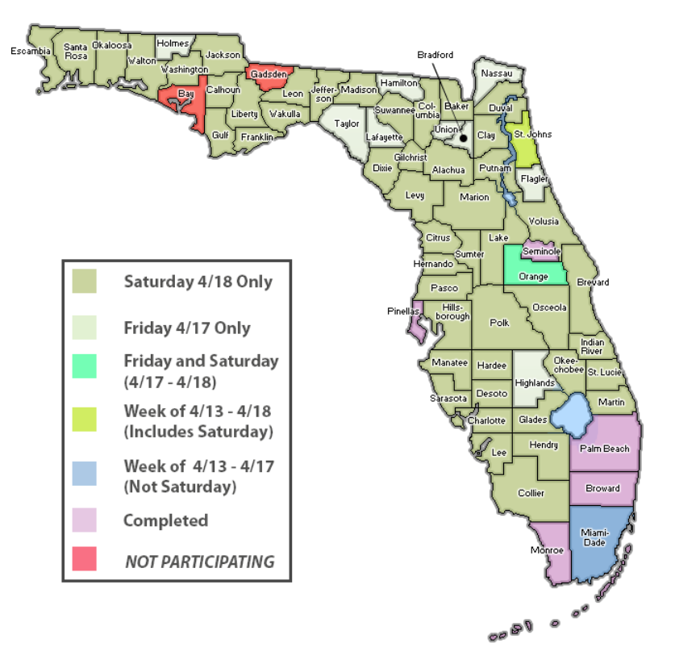


Slide 4
COST/BENEFIT ANALYSIS
Cost: 2% of Total Revenue = ROI 3,979%
Cost: 8% of Total Clerk Revenue = ROI 1,140%

Slide 5
Revenue Generated by Peer Group

Slide 6
Top 3 by Revenue Generated by Peer Group

Slide 8
Wrap–Up
Send your final media release and/or stories
Provide feedback/Recap Project
Thank you to all the Clerks and Staff!!

