Slide 2
RESTORATION FLIGHT PLAN

Slide 3
Hampton Peterson, Esq.
Legal Counsel
Palm Beach County Clerk and Comptroller’s Office
Notes:
Welcome – Clerk Butterfield

Slide 4
Criminal Judgment Negotiations
Presenter:
Hampton Peterson , Esq. Legal Counsel
Clerk & Comptroller, Palm Beach County

Slide 5
PBC Assessments Reduced to Judgment
Cases Reduced to Judgment since 2004:
134,027 Cases
Total Judgment Amount Due:
$140,251,285.12

Slide 6
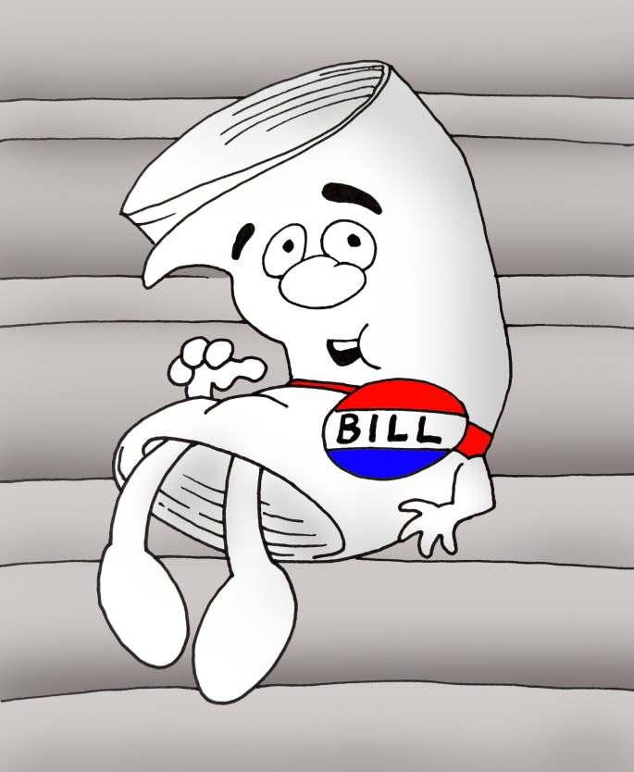
938.30 Financial obligations in criminal cases; supplementary proceedings.
(9) The clerk of the court shall enforce, satisfy, compromise, settle, subordinate, release, or otherwise dispose of any debts or liens imposed and collected under this section in the same manner as prescribed in s. 938.29(3).

Slide 7
Pilot Criteria
Selected a target group of cases.
Prison sentence was complete.
Had private attorney at time case was resolved.
Since prison release, defendant has not been re-arrested.
Mail settlement letter.

Slide 8
Palm Beach County Settlement Letter
VIA U.S. MAIL
RE: State of Florida v. Corey L. Dempsey,
Case No. 2008CF010114BMB
Dear Mr. Dempsey:
On February 10, 2009, the Court signed an Order Assessing Additional Charges and Fines and Entering Judgment in the above-referenced action, which is attached.
The Clerk & Comptroller, Palm Beach County is charged with the collection of these amounts. To date, we have only received $147.59 towards these fines. The total balance due at this time is $102,970.41.
Furthermore, the judgment bears interest at the rate prescribed by law until satisfied. Please contact our office as soon as possible to discuss a settlement amount and resolve this outstanding judgment.
Sincerely,
Hampton C. Peterson
Legal Counsel & Ethics Office
Clerk & Comptroller, Palm Beach County

Slide 9
Palm Beach County Pilot December 2015
Drug Trafficking 23 Letters
Outcome | # of Responses | Age of cases:
Settlements | 14 | 1987- 2005 = 6 cases 2006-2009 = 13 cases 2010-2011 = 2 cases
Additional cases on payment plans | 7
Did not respond | 2 | -

Slide 10
How are negotiations initiated?
Customer or attorney contacts our Court Compliance Team (CCT) to determine any outstanding balance(s) due.
CCT determines whether defendant is able to pay in a lump sum or via payment plan.
CCT will refer defendant to Clerk’s Legal Counsel to negotiate settlement/payment plan amount.

Slide 11
Negotiation Considerations
Attempt to collect entire amount of assessment.
Negotiate collection agency surcharge/accrued interest to reduce amount due.
More flexibility in negotiating older cases with higher assessments.
Consider length of time a payment plan will take to pay in full vs. a lump sum settlement.
Something is better than nothing!

Slide 12
Tools
Full Public Records Search including property, civil judgments, civil and criminal cases.
Facebook, Instagram, LinkedIn, Google.
DOC Website.
Information on immediate family members.

Slide 13
Distribution Formula
Determine the total percentage of the fee associated to each tier.
FORMULA:
2. Determine the amount to be assessed for each tier.
FORMULA:
Total of the Tier | ÷ | Total Assessment | = | % per Tier
% per Tier | x | Total Settlement Amount | = | New Tier Amount

Slide 14
Example of Settlement #1 State v. Gilles
2010 case and the original assessment was $53,068.00
INFORMATION
Thomas Giles was released from the Department of Corrections on 5/25/15 at the address of 4268 Oakridge Place, Biloxi, MS (Harrison County), which is a property that he and Pamela Giles currently own through a life estate of Mrs. Ella Flynn.
In a few of his criminal cases he was with a co-defendant by the name of Jennifer Marie Fredrich. Very little information could be found on her.
There are no cases in his name and the only thing recorded is relating to his criminal judgment.
He does have a Facebook account and it appears he has a daughter in Mississippi and he states that he graduated from the University of Southern Mississippi on 2003.
A friend of his from the Fern House wrote a letter to the Judge about how Giles in an eight month period in 2010 helped over 300 addicts recover from addiction .
He does not own any property here in Florida and his previous addresses used have changed multiple times over the years.

Slide 15
Results Settlement #1 State v. Giles
$53,068; settled for $15,000
Compromise Considerations
Recalled from collections $21,227.20
Waived interest
Reduced assessment
Formula
Reduce the following tiers by the percentage:
# 1 | General Revenue (% x Settlement)
# 2 | COC Trust Funds (% x Settlement)
# 3 | State Trust Funds-Pro Rata (% x Settlement)
# 4 | Local Funds- Pro Rata (% x Settlement)

Slide 16
Distribution of Judgment State v. Giles
TIER | Total
 | Original Assessment |  | Adjusted Assessment
 | $53,068.00 |  | $15,000.00
 | Breakdown
 | Original Assessment | % Distributed | Adjusted Assessment
General Revenue | $45,025.80 | 84.8455 | $12,726.82
COC Trust Fund | $5,006.85 | 9.4349 | $1,415.22
State Trust Funds | $2,718.00 | 5.1216 | $768.26
Local Funds | $317.35 | .5981 | $89.70
Total of the Tier | ÷ | Total Assessed | = | % Distributed per Tier

Slide 17
Example of Settlement #2 State v. Lewis
2014 case - Original Assessment $53,093.00
INFORMATION
Mr. Lewis was sentenced to 5 years in prison in 2015.
After completing his sentence early, he was released in 2019. He attended a reentry event and obtained the assistance of the Public Defender and the Clerk’s Office.
His goal was to obtain his driver’s license to enable him to find employment.
He does not own any property here in Florida and his previous addresses used have changed multiple times over the years.

Slide 18
Results Settlement #2 State v. Lewis
Compromise Considerations
Collection Agency Fee waived.
Because of Mr. Lewis’s financial situation, we required a minimal initial payment in order to set up a payment plan.
Payment plan took into consideration his ability to pay - $20.00 per month.
Mr. Lewis was able to reinstate his license and is current with payments.
Notes:
Paid $25 payment plan fee and the $7 affidavit fee to reinstate DL.

Slide 19
Example of Settlement #3 State v. Perrotta
Defendant had 11 criminal cases with total due of $8,625.07
Information:
Ms. Perrotta attended a Clerk & Comptroller speaking event regarding our Court Compliance Program.
She stated a relative was willing to pay a lump sum in order to settle all cases.
Compromise Considerations:
Collection Agency fees recalled.
Waived interest on all cases.
Adjusted assessments on cases to allow full payment of fines on criminal cases to meet settlement amount.

Slide 20
Results Settlement #3 State v. Perotta
# | Case number | Amount Assessed | Amount Settled
1 | 2010CF014819 | $1366.59 | $303.63
2 | 2010MM014181 | $297.16 | $149.52
3 | 2011CF003816 | $1287.25 | $303.62
4 | 2011CF003817 | $1287.25 | $303.62
5 | 2011CF011005 | $1266.57 | $303.62
6 | 2011CT030064 | $264.60 | $189.00
7 | 2011MM001837 | $496.48 | $253.00
8 | 2011MM002867 | $683.23 | $303.62
9 | 2011MM015648 | $673.54 | $303.62
10 | 2014MM002118 | $501.20 | $303.62
11 | 2014MM012048 | $501.20 | $303.62
 | TOTALS: | $8625.07 | $3020.49
Notes:
Amount assessed column includes interest and collection agency surcharge.

Slide 21
Palm Beach County Settlement Results
483 cases settled/established payment plan
$ 711,869.84

Slide 22
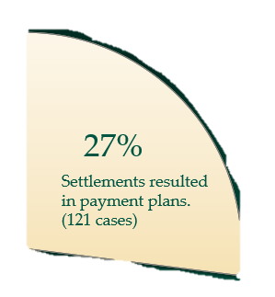
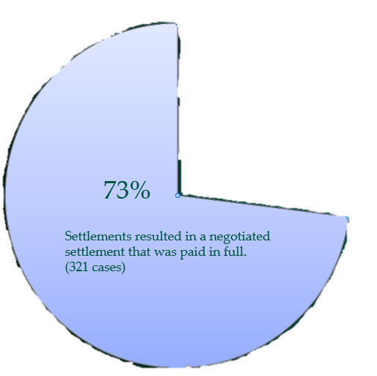
PBC Settlement Breakdown
442 Cases Settled/Established Payment Plan
Delinquent (36)
Current with Plan (55)

Slide 23
A Thank You!
I just wanted to share my experience with you about my experience being able to pay off my past court fines through a settlement.
I’m clean and sober now for 4 years and as a part of my recovery (and to move forward in my career in substance abuse counseling) I needed to ‘make amends ‘ for my past.
Part of that was offering a sincere apology and changed behavior to the court system and law enforcement, which I did.
The other part was to clear up any financial amends as well. When I discovered the unpaid court costs I was completely overwhelmed! I did not have the resources to pay those fines.
But I knew I had to try.
Notes:
15 cases from 1993 until 2007. with interest and collection fees over $7000 owed. Base court costs and fees $4,000. Settled a lump sum of $2000 plus any clearance fees.

Slide 24
A Thank You!
That’s when Faith Campbell stepped in. She assured me that it was possible and helped me find a resolution!
I’m truly grateful for her help and feel that I can move forward now, with a clean slate and be the best person I can be.
Thanks for all the help!
Julie Kemp

Slide 25
QUESTIONS?

Slide 26
“OPT-IN” COMPLIANCE PROGRAM

Slide 27
Douglas Isabelle
Deputy Executive Director Florida Clerks of Court Operations Corporation
Notes:
Welcome – Clerk Butterfield

Slide 28
THE LAW
Section 938.30, F.S. provides Clerks with authority to “enforce, satisfy, compromise, settle, subordinate, release, or otherwise dispose of any debt or liens imposed and collected”.
May 2012– Opinion
“… If it was the not the intent of the Legislature to allow the Clerk to negotiate the release of the debt or lien for any reason other than full payment the language would have been restricted to requiring the Clerk to satisfy the judgment lien upon full payment”.

Slide 29
Criminal Liens CFY 2015-16 through 2017-18
Statutorily mandated criminal fines constitutes most of the judgment/liens.

Slide 30
Circuit and County Criminal Judgment/Liens CFY 2015-16 through 2017-18
Felons owe most of the judgment liens.

Slide 31
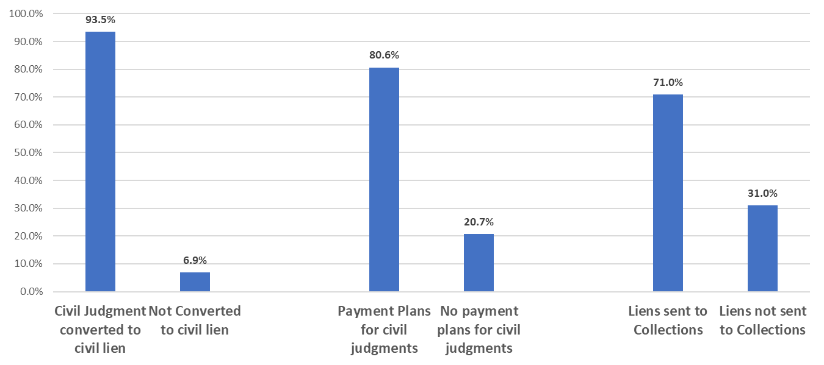
County Treatment of Judgment/Liens For Criminal Cases

Slide 32
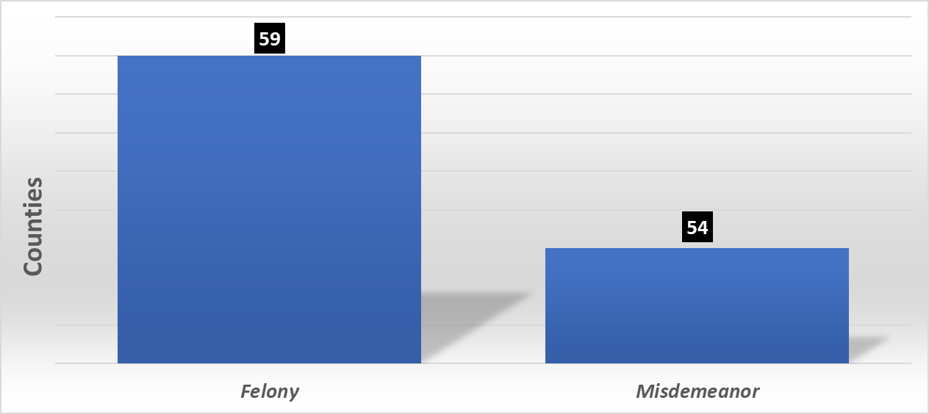
Counties That Record Criminal Judgments/Liens

Slide 33
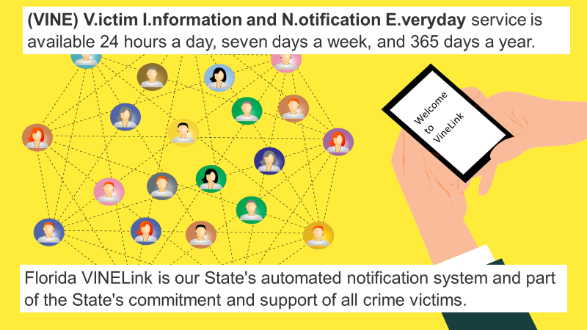
FLORIDA DEPARTMENT OF CORRECTIONS
Clerk Best Collection Practice: Section III. A. 5

Slide 34
Centralized
Decentralized
vs.

Slide 35
FUTURE CONSIDERATION OF PILOT TEST AT STATE LEVEL
Centralizing compliance and collections at the state level has been discussed in the past.
Child Support State Depository has been used as example.

Slide 36
“Opt-In” Program for Collecting Criminal Liens
Criminal
Liens
Request the Legislature authorize a 3 year “Opt-In” Pilot Program.
The FCCC and/or CCOC contract with a pool of attorneys (could provide some pro bono work) to provide legal services.
Clerks decide whether they would “Opt-In” for these services.

Slide 37
“Opt-In” Program for Collecting Criminal Liens
Criminal
Liens
If a Clerk “opts-in” they would transmit the necessary account information in order to contact the defendants and/or their attorney.
Attorneys would be provided guidelines for negotiations.

Slide 38
“Opt-In” Program for Collecting Criminal Liens
Criminal
Liens
The results, including payment plan terms and conditions and any collected dollars would be transmitted back to each Clerk.
The CCIS or other statewide system could be used to transmit account information.

Slide 39
“Opt-In” Program for Collecting Criminal Liens
Criminal
Liens
The Legislature would authorize a annual grant to fund the program.
Progress reports and program results would be provided to the Legislature for final decision.

Slide 40
“Opt-In” - Other Services
Community Service
Notify
Call
Center
Criminal
Liens

Slide 41
FUTURE CONSIDERATION OF PILOT TEST AT STATE LEVEL
Centralized services could include some and/or all services that are currently provided at the local level:
Electronic payment plans
Call Center
Promotions
Centralized Community Service Programs is also option as currently being done in California.

Slide 42
Key to Successful State Level “Opt-In” Program
REQUIRE courts to recommend ALL defendants not paying in-full to the Clerk to establish a payment plan immediately upon sentencing. NO time delays. Which would be electronically remitted to a centralized compliance/collection entity.

Slide 43
“Opt-In” Program for Community Service
Community Service
Service Providers can also enroll in program as new participants or through Probation Service referrals.
Must qualify provider ability to perform in community service program including commitment to track and report hours through online tool.

Slide 44
“Opt-In” Program for Community Service
Community Service
Pilot introduction would work with up to 3 counties to set up online site, enroll providers, enroll participants, and track progress.
Once pilot program is completed, other counties enroll into service.

Slide 45
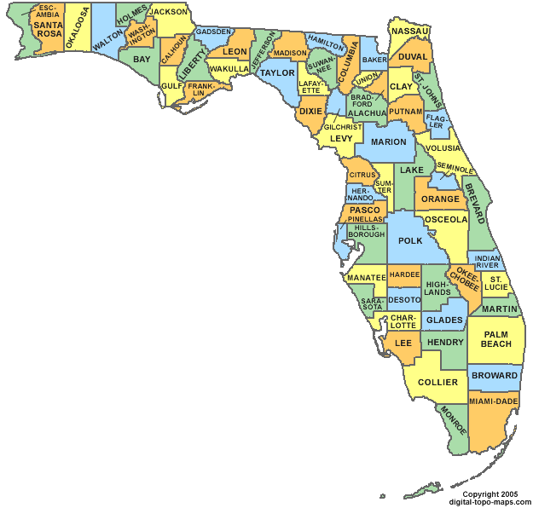
Online Community Service Tracking
Statewide visibility of providers can be generated that shows who is available at various counties throughout the state in a map page.
Statewide statistics in program can be generated to demonstrate participation.

Slide 46
QUESTIONS?

Slide 47
Rose Devoe
Deputy Chief Administrator
Duval County Clerk and Comptroller’s Office
Notes:
Welcome – Clerk Butterfield

Slide 48
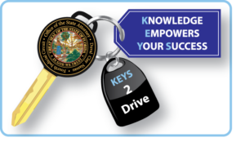
Duval County K.E.Y.S 2 Drive Knowledge Empowers Your Success To Drive
Rose Devoe
Deputy Chief Administrative Officer
Duval County Clerk of Courts

Slide 49
KEYS 2 Drive – What is it? Who Qualifies?
KEYS 2 Drive is a voluntary driver’s license diversion program created by the State Attorney’s Office in the 4th Circuit to help certain traffic offenders obtain a valid driver’s license.
Who Qualifies:
Criminal defendants who are currently charged with a Misdemeanor Driving While License Suspended (322.34) or No Valid Driver License (322.03)
Exceptions:
Sexual Predators or Sex Offenders
Active DUI suspensions, or convictions for DUI Serious Bodily Injury
Aggravated Fleeing or Attempting to Elude a Law Enforcement Officer
Leaving the Scene Involving injury or Death, Vehicular Homicide, Drug suspensions
No other accompanying criminal charge
Cases that resulted in an accident that involves property damage or personal injury to a third party (maybe accepted with consent of the victim), out-of-state residents.
Must have legal immigration status at the time of referral. Undocumented and/or unauthorized immigrants are not eligible.
Program participants may not be on probation (Exception if the court having jurisdiction consents)
HTO offenders may not be referred from First Appearance. Some HTO offenders may be diverted at the discretion of the state attorney’s office.

Slide 50
KEYS 2 Drive – When did it start? How does the process work?
KEYS 2 Drive launched in Duval County on May 21, 2018.
How does the process work?
Defendant referred from Traffic Court/1st Appearance – Case passed for 45 days
Case reviewed, defendant accepted into the program – Case then passed for (90) day status
Vendor assigns Defendant a Case Manager-remains in program from
3-6 months. No more than 12 mos.
CM provides Deft. A form outlining outstanding cases and amounts due to arrange payment plans
Defendant visits COC – 1 time collections recall - payment plans created for all cases
Defendant obtains a valid driver license – continues to make payments
Defendant reports to vendor Monthly until fees are paid in full or compliant on all payment plans
Defendant remains arrest- free, continues in program and appears at all court proceedings
Defendant pays all outstanding fees or shows substantial progress
Case Dropped by State Attorney - Deft. complies w/PP or Lic. Susp. & case(s) returned to collections

Slide 51
KEYS 2 Drive – How much does the offender pay?
Defendant pays a total of $200.00 - $250.00. to participate in program:
Vendor fee is $150.00 - If the defendant has more than one DWLSR or No Valid Driver License case and requires additional supervision to obtain a valid license, the vendor fee is $200.00
Defendants are permitted to pay the fee in installments.
State Attorney (4th Circuit) fee is $50.00.
Fee is due prior to successful completion of the program.
Fee may be submitted by vendor or,
Fee may be made to the state attorney’s office
***If an in-house Clerk program was utilized the cost to the defendant would be $25.00, this results in a savings of $175.00 - $200.00 that could be used towards outstanding fines.

Slide 52
KEYS 2 Drive – What are the (1 ) year compilations?
KEYS 2 Drive launched in Duval County on May 21, 2018.
By May 2019 (1 year):
2,420 defendants referred
1,885 defendants accepted
535 defendants rejected
- Non-compliance
- Failure to Report
- Elected not to participate
197 defendants returned to collections

Slide 53
KEYS 2 Drive – What are the (1 ) year compilations?
375 defendants have paid all pending citations in full.
6% of Accepted Cases remain in Collections.
37% Dropped Cases.
57% Cases with In-Program Receipts.
Per vendor - 650 defendants have obtained valid driver licenses.
In excess of $600,000. in Revenue, of which $200,000. is estimated
to be deposited into the Clerk Trust Fund.
Hidden Figure – In excess of $250,000.+ in lost revenue from
dropped cases.

Slide 54
KEYS 2 Drive Clerk Challenges - Questions???
Challenges for the Clerk:
Vendors limited knowledge of FLHSMV sanctions.
Inaccurate calculation of late fees and payment plan fees when defendants referred to COC.
All outstanding citations not identified by vendor.
Defendants improperly advised about requirements with COC.

Slide 55
QUESTIONS?

Slide 56
LIFT-OFF FLIGHT PLAN
PANELISTS
Tara Green– Flight Commander
Chris Hart – Payload Commander
Sara Sanders– Payload Specialist
John Dew– Mission Specialist
Jason Welty– Lunar Module Pilot

Slide 58
SUCCESSFUL MISSION
CLOSING REMARKS

Slide 59
Honorable Tara S. Green
Clerk of Court
Clay County Clerk of the Circuit Court’s Office
Notes:
The Proactive Clerk – Clerk Green

