Slide 2
PREVENTION FLIGHT PLAN

Slide 3
Kathy Davis
Business Analyst Administrator
Citrus County Clerk and Comptroller’s Office
Notes:
Welcome – Clerk Butterfield

Slide 4
Compliance 20: [Mission to Drive] Citrus County Kathy Davis kdavis@citrusclerk.org
Serving together …dedicated to excellence!

Slide 5
Citrus Collections
Payment Plans Total Active Plans | $26,854,558
Active Payment Plans as of 9/30/19 | 1312 (1655 cases)
Average Payment | $ 58.39
Average Amount collected monthly | $ 86,103
Collection Agencies # cases sent FY18/19 | 3448
Total Dollars Sent to Agencies FY18/19 | $ 2,385,746
Collected by Agencies 16% rate | $ 377,699
Total Amount sent to Collection Agencies | $ 21,893,129
1464 Cases recalled in FY18/19 | $ 1,216,004
Notes:
Payment plans include cost of incarceration

Slide 6
Court Payment Plans
Notes:
FY18/19- 2653 plans, (appx 2691 cases) sy17/18 2091 27% increase # plans

Slide 7
Court Payment Plans
Administrative Payment Plan Fee Collected

Slide 8
Payment Plans
Notes:
EC report shows collections total for court FY18/19 $2,810,537.90 1033240+67289= 1100529 39% collection thru payment plans 13% is thru collection agency ($377,699.)

Slide 9
Payment Plans
33%
FY18/19 | CF | CJ | CT | DR | MM | TR | Total
# Plans Established | 848 | 17 | 541 | 12 | 650 | 586 | 2,656
# Plans Failed | 331 | 7 | 191 | 3 | 253 | 96 | 881

Slide 10
Compliance – NEW DAY
Changed our mode of operations for compliance
Began Online Payment plan application process
Initiated text messaging, email notices and postcard reminders
Placed placards on buses to send message that we are here to help citizens renew DL and maintain payment plan
Allowed customers to combine multiple plans into one payment
Allowed more flexibility with payment dates and extensions

Slide 11
Compliance 20
Number of affidavits provided for DL reinstatement
Notes:
OGL Oct 2019 was our 7th event for DL clearance- 158 of the 4666

Slide 12
Notes:
Average 388 month, during DL event spike in March

Slide 13
Payment Plans Analysis
781 plans initiated between 6/1/19-8/31/19 -190 plans defaulted
Notes:
Postcards

Slide 14
What’s working?
Notifications must be timely
Online process must be easy to maneuver
Analytics of processes can be labor intensive
ACH- automate payments
Reduce foot traffic with online phone, other places to remit payment
Method of contact | # Sent | # Paid
Email | 75 | 10
Postcard | 143 | 35
Text | 189 | 38

Slide 15
DL reinstatement events
Notes:
1.2 million we call back to put individuals on PP- our agencies can also place them on a plan, during event only 258 are called back of the 1464.

Slide 16
Signs in Courthouse

Slide 17
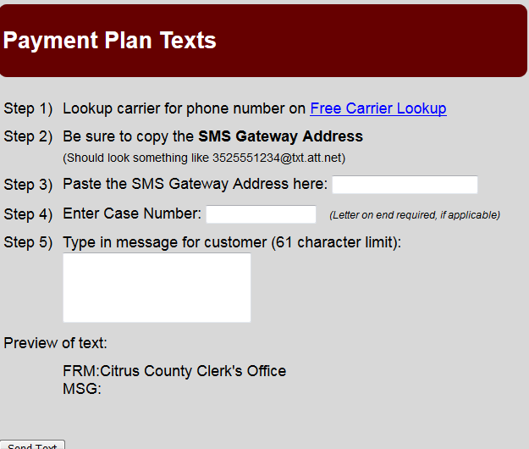
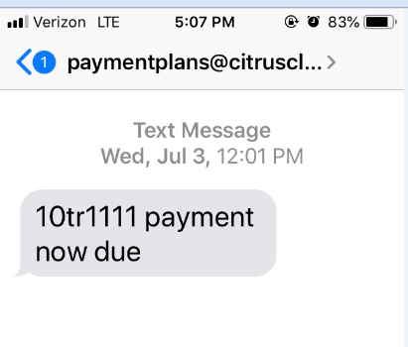
Text Messaging

Slide 18
Postcard reminders
Signs in Courthouse

Slide 19
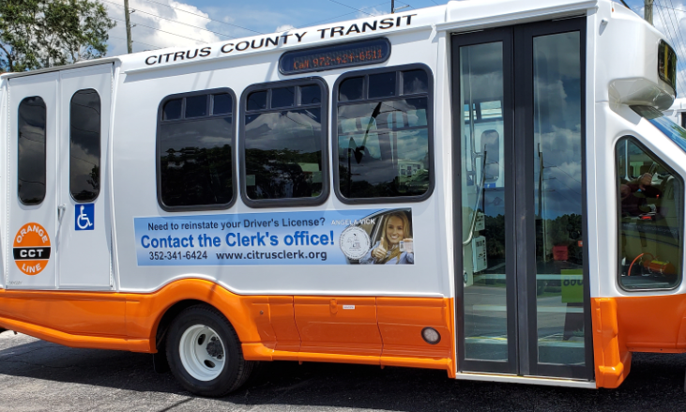
Wraps on Buses

Slide 20
Brochures

Slide 21
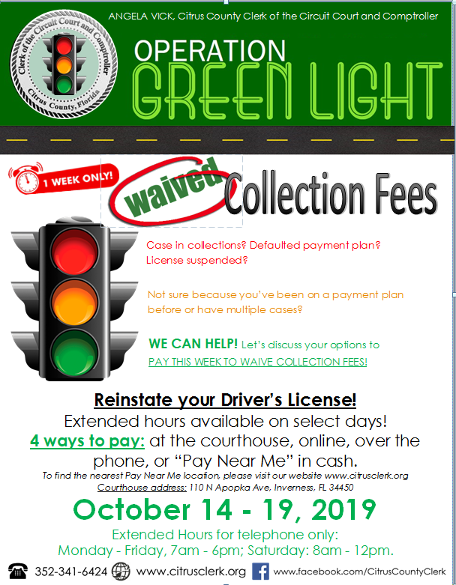
Saving Events

Slide 22
Thank you!

Slide 23
QUESTIONS?

Slide 24
PREVENTION FLIGHT PLAN

Slide 25
MEDIATION FLIGHT PLAN

Slide 26
PANELISTS
Honorable Don Spencer
Clerk of Court
Santa Rosa County Clerk and Comptroller’s Office
Notes:
Welcome – Clerk Butterfield

Slide 27
PANELISTS
John Venable
Chief Duputy
Santa Rosa County Clerk and Comptroller’s Office
Notes:
Welcome – Clerk Butterfield

Slide 28
PANELISTS
Honorable Nadia Daughtrey
Clerk of Court
DeSoto County Clerk of the Circuit Court
Notes:
Welcome – Clerk Butterfield

Slide 29
PANELISTS
Kristi Wagstaff
Collections Supervisor
Polk County Clerk of Courts & County Comptroller’s Office
Notes:
Welcome – Clerk Butterfield

Slide 30
PANELISTS
Gina Magana
Central Cashiering Manager
Saint Lucie County Clerk of the Circuit Court’s Office
Notes:
Welcome – Clerk Butterfield

Slide 31
Buy In:
Judicial buy in is essential!
It frees up dockets and promotes judicial economy.
Judge informs them of their options.
What we ask Judges to say.
“Your Fines and Fees are due in full today. Please go to the Clerk’s office before leaving the Courthouse and either pay your fees in full or sign up for the Clerk’s partial payment plan.”
If defendant is incarcerated, “Your fines and fees are due within 90 days of your release from incarceration. Go to the Clerk’s office within that 90 days of release and either pay your fines and fees in full or sign up for the Clerk’s partial payment plan. If you fail to report to Clerk’s office within 90 days of release a judgement will issue.”

Slide 32
Buy In:
They are directed to go to Clerks office with their minutes that day immediately after court.
They are given their minutes in a blue folder to identify them.
Court Security knows to look for people with those blue folders. They help direct the defendant to the Clerk’s office.
Probation works w/ Clerks office to ensure payment of fines and fees.

Slide 33
Failure to Pay:
Process notification cards, informing of license suspension if they do not contact Clerk for delinquent fines and fees.
Emphasize to them to let Clerk know if there is a problem.
Flexibility is key to success.
Work with customer on missed payment as long as it is not a regular request.
Fosters a relationship with the customer/defendant that keeps them engaged.

Slide 34
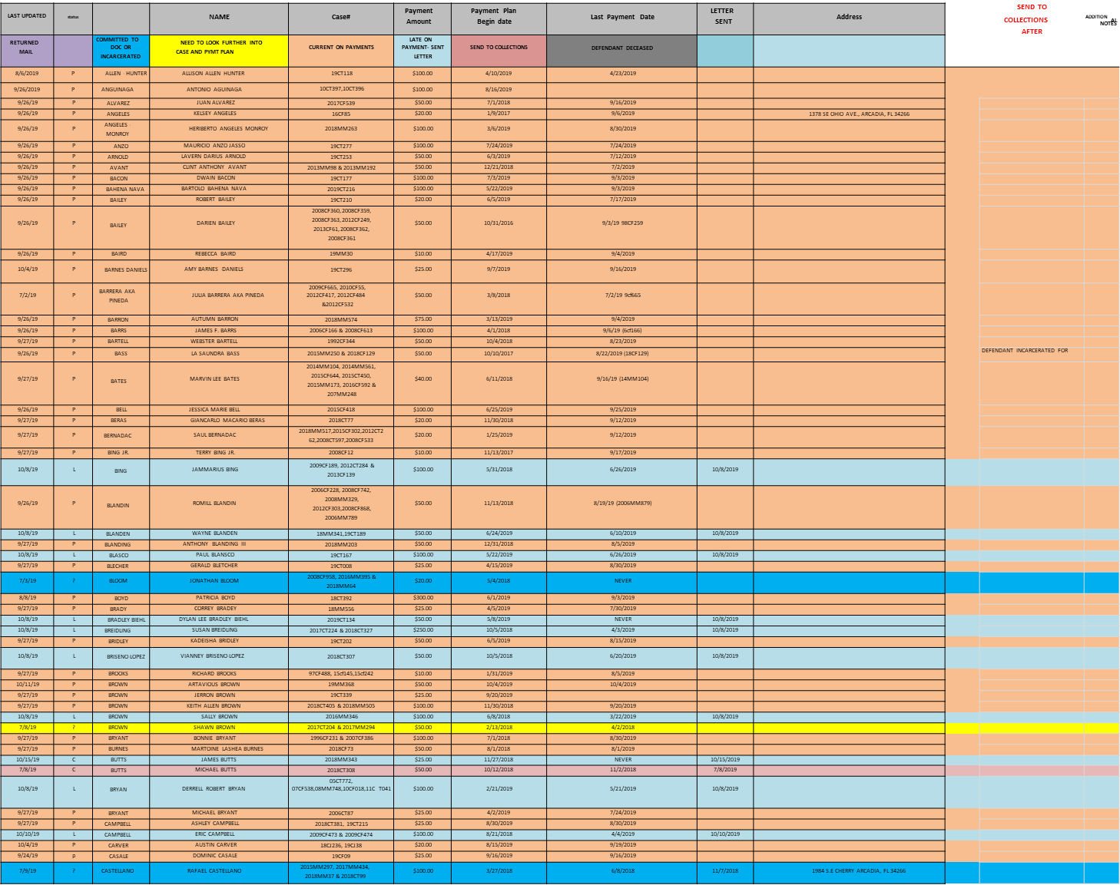
Payment Plan Tracking in Excel for DeSoto Payment Plans
Returned Mail | Status | Commited to DOC | Name | Case | Payment Amount | Begin Date | Last Payment | Letter Sent | Address

Slide 35
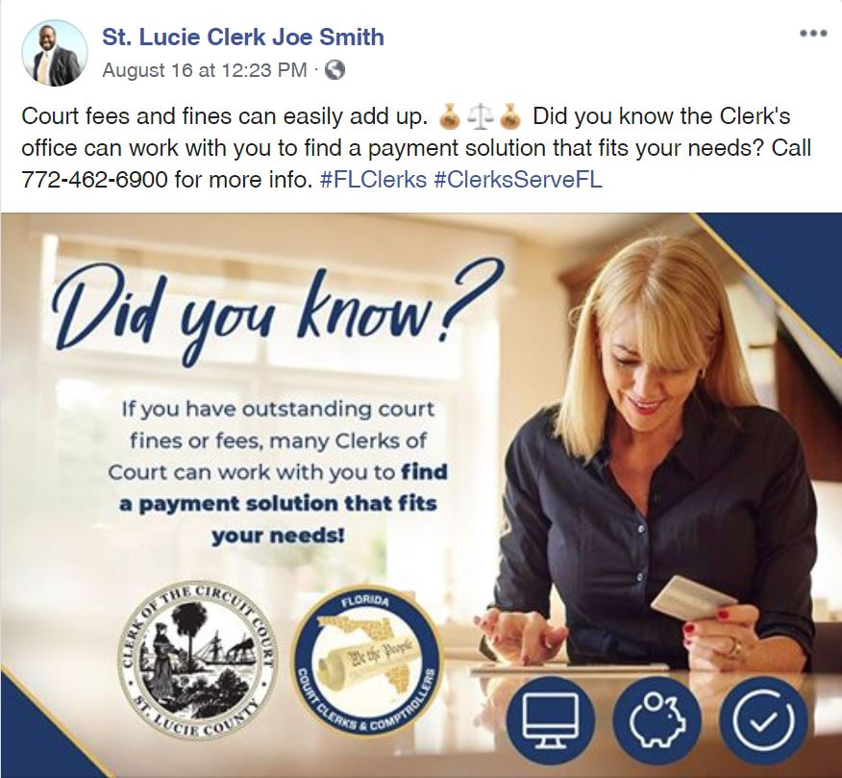

Slide 37
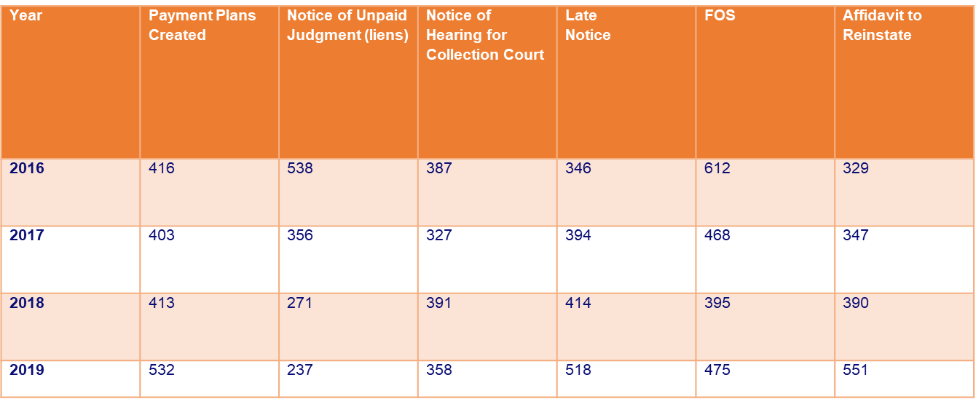
Saint Lucie Monthly Collection Actions

Slide 38
Saint Lucie Compliance Tools
Notice Process
First Notice
Notice of Fines
Second Notice
Collection Court
Third Notice
Payment Plan
Final Jugment
Notice of Unpaid Judgment
Default Notice
Final Notice
FOS
Collection Agency
Case Recall

Slide 39
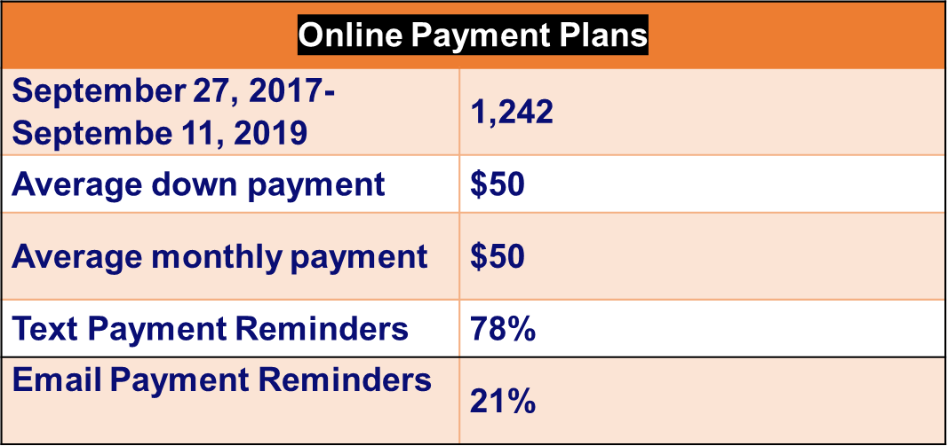
Saint Lucie On-Line Payment Plans
Launched—September 2017

Slide 40
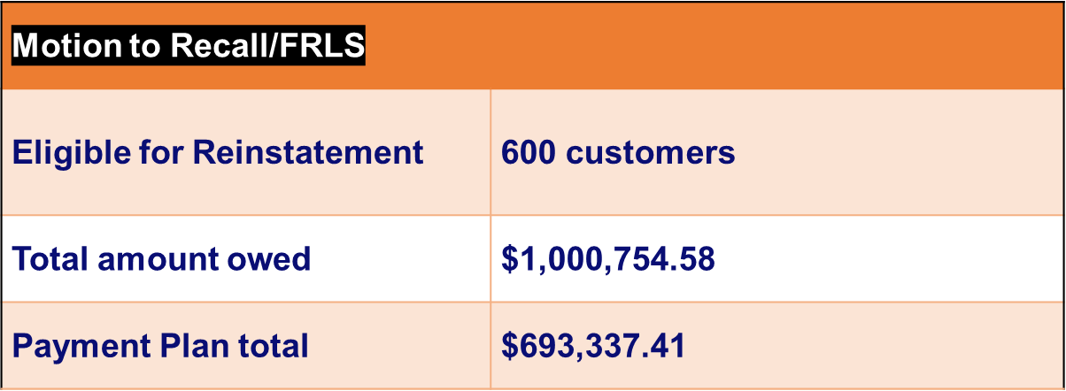
Saint Lucie Working with Florida Rural Legal Services
Launched—September 2018

Slide 41
Success!:

Slide 42
QUESTIONS?

Slide 43
MEDIATION FLIGHT PLAN

Slide 44
BREAK

