Slide 1
J.K. "Jess" Irby, Esq. Clerk of the Court & Comptroller
Alachua County
Driver License
Reinstatement Clinic
June 13, 2019

Slide 2
Participating Agencies:
Court Administration
Clerk of Court
Tax Collector
Florida Highway Safety and Motor Vehicles
FLHSMV - Bureau of Administrative Review Hearing Officer
State Attorney
Public Defender
Florida Department of Revenue
Sheriff’s Office
UF Smart Driver Rehab

Slide 3
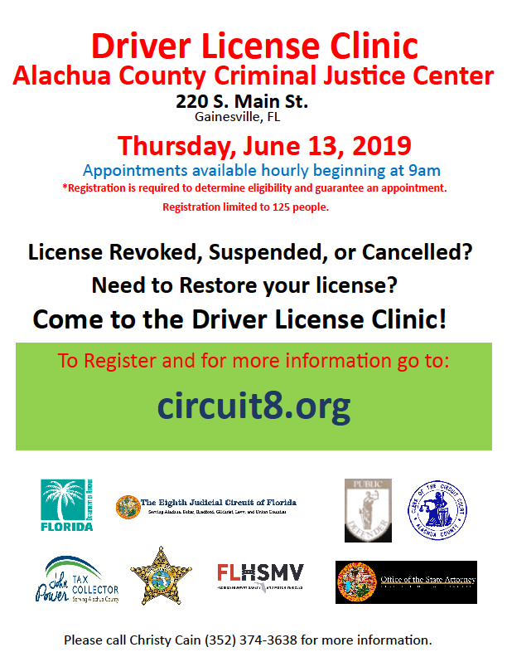

Slide 4
Court Administration Issued Two Press Releases
Second release added additional information for clinic.

Slide 5
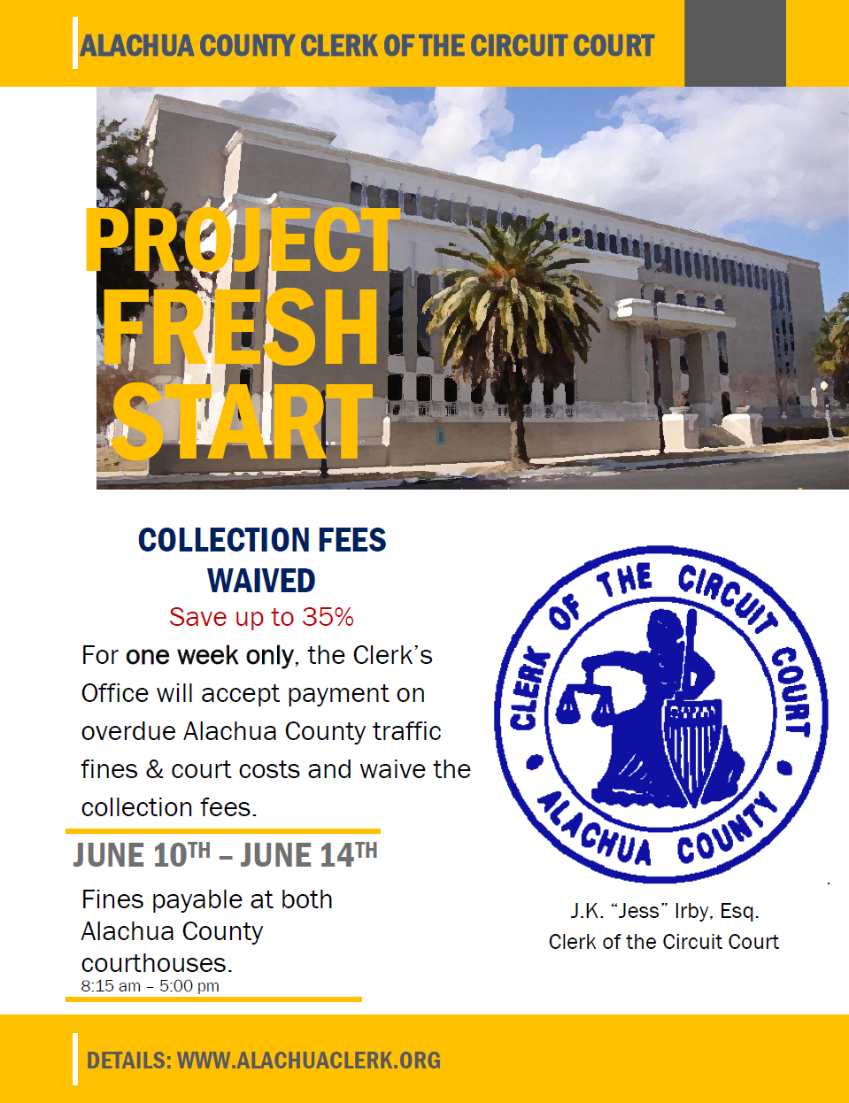
Clerk of Court Announced “PROJECT FRESH START” Collection Fees Waived For Everyone June 10-14

Slide 6
Local and Social Media Spread The Word

Slide 7
Court Administration Developed An Online Registration Form
Information requested:
Name
Date of Birth
E-Mail Address
DL Number
Address
Phone Number

Slide 8
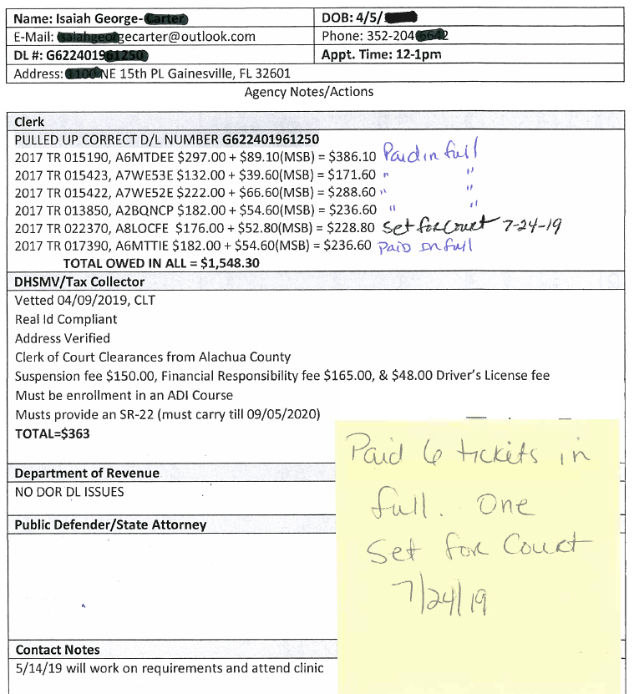
Participating Agencies Reviewed Registrants in Batches of 25. One Master “Cover Sheet” For Each Applicant
187 Registered
135 Given appoints after confirming
and vetting. One hour increments 9am-2pm (27/hr).
63 Participants (51 + 12 walk-ins)

Slide 9
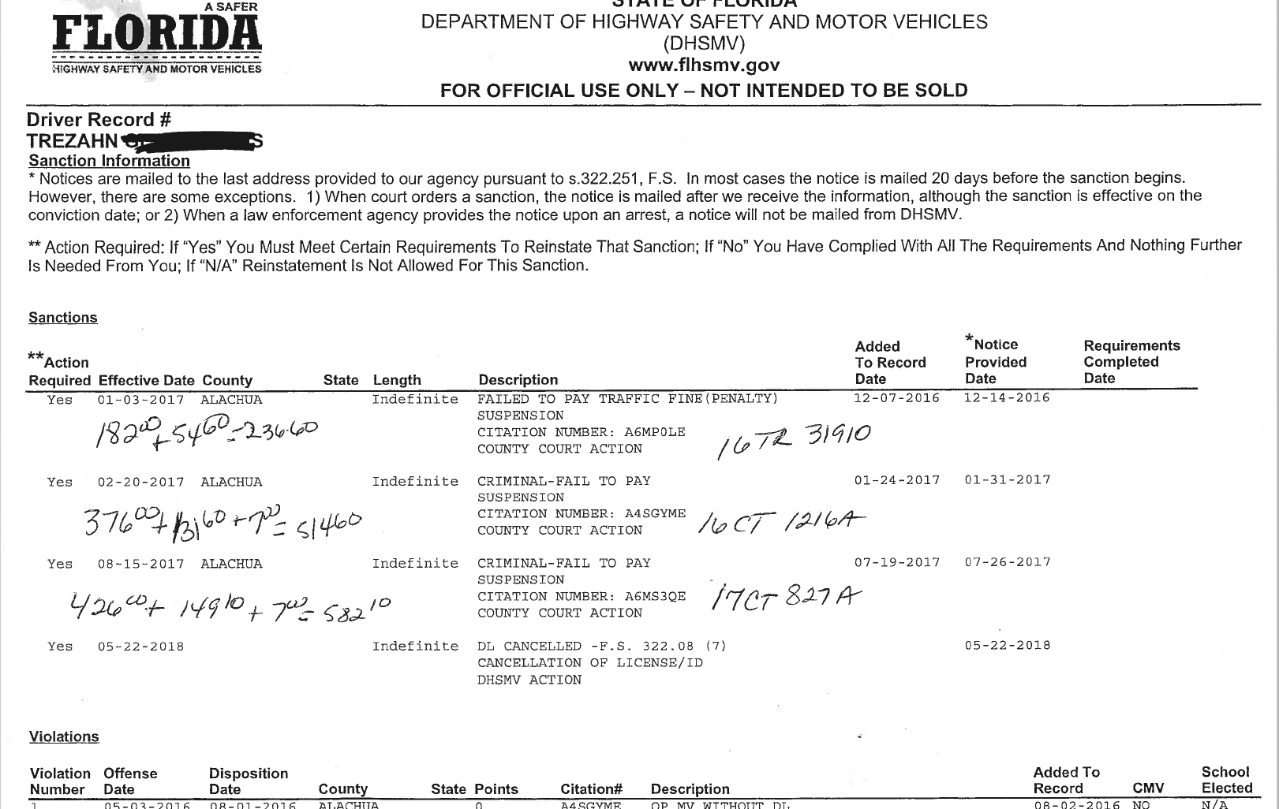
Each Agency Listed Applicable Obligations On The Cover Sheet For Each Registrant The Clerk’s Office listed any outstanding assessments. Many had multiple cases that would need to be addressed to make the person eligible for reinstatement.

Slide 10
Court Administration operated a check-in station. An intern was assigned to each participant and stayed with them for the day to ensure they never got lost.
Interns from UF Law did a great job assisting the registrants.

Slide 11
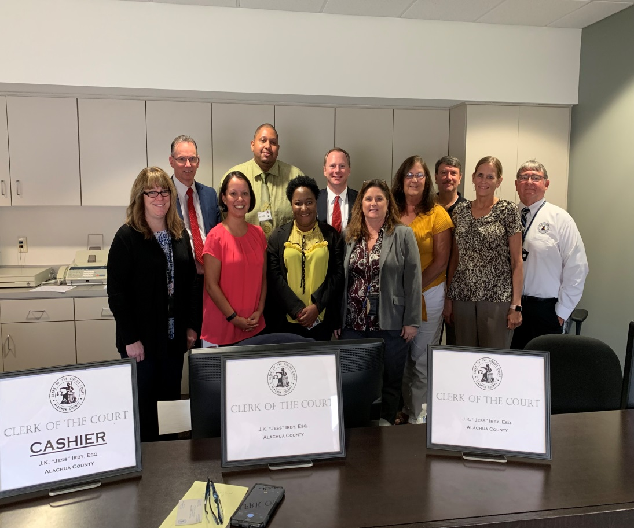
Clerk staff greeted each registrant, provided a copy of the cover sheet with explanations, took and receipted any payments, and gave guidance as to the next agency to go see.

Slide 12
The Tax Collector, on behalf of DHSMV, did the DL research on a statewide basis.

Slide 13
The Bureau of Administrative Review Hearing Officer was present to hold on-site hearings.

Slide 14
Two County Court Judges rotated in a nearby courtroom for hearings on payment plans and permission to perform community service. A JA was present, along with two Deputy Clerks to process orders.

Slide 15
Forms / Order Used To Request And Grant Community Service

Slide 16
Regional Counsel And The Public Defender Were Present To Give Assistance If Needed

Slide 17
DHSMV Brought The Mobile Driver’s License Unit (FLOW) Could Do Everything. Including Printing New Licenses.

Slide 18
Event Held In Jury Assembly Room With Each Participating Agency Having A Booth

Slide 19
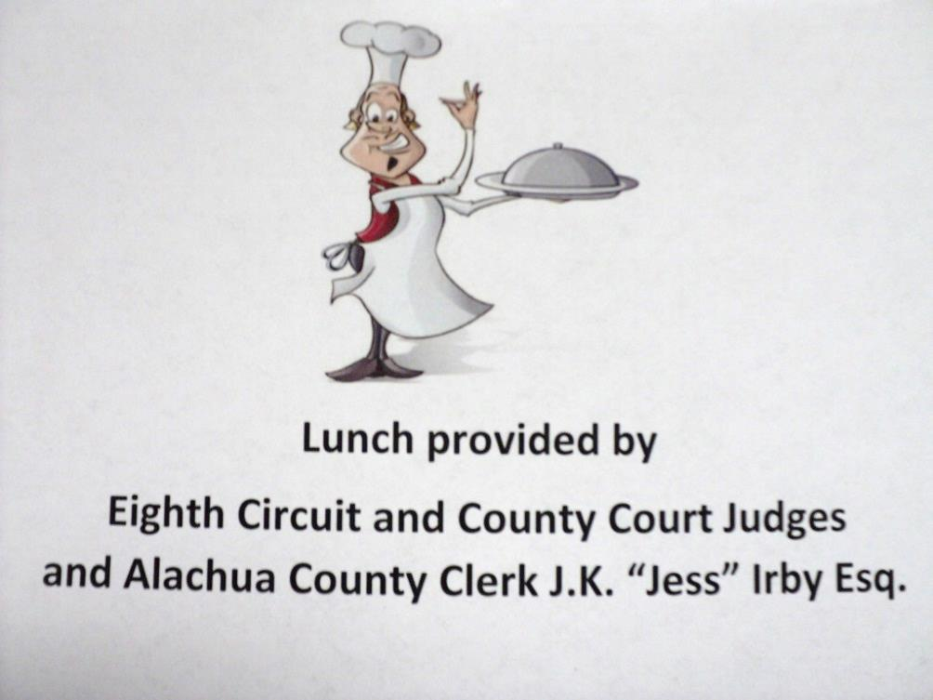
Breakfast, Lunch, And Snacks For Staff

Slide 20
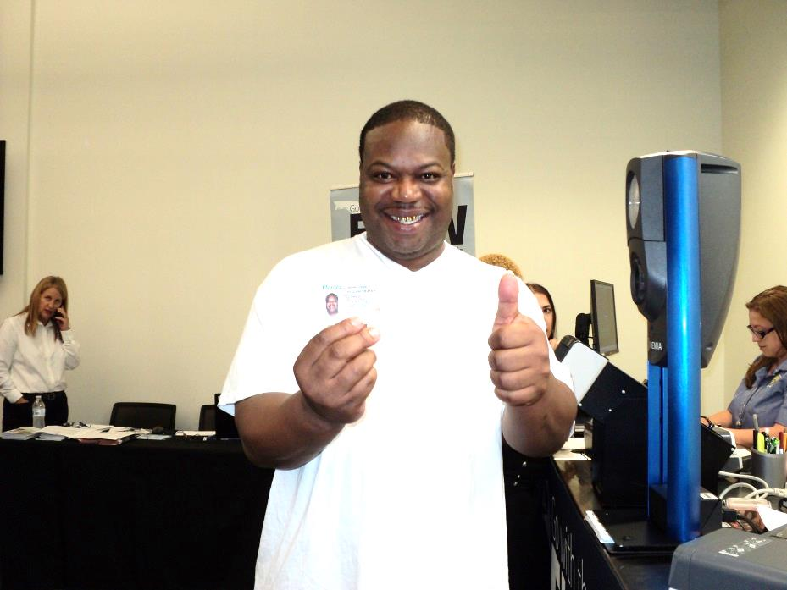
A number of registrants left with a new driver’s license in hand. One had a job waiting once he had a license.
MANY HAPPY SMILES

Slide 21
General Information - Summary of Activity
Project Fresh Start
Cases Resolved:
75
Court Costs and Fines Paid:
$15,774.50
Collection Fees Waived:
$5,010.38

Slide 22
J.K. "Jess" Irby, Esq. Clerk of the Court & Comptroller
QUESTIONS?

