Slide 1
Mission Possible: Optimizing Compliance Tools

Slide 2
Mission Possible: Optimizing Compliance Tools

Slide 3
What is Possible? Challenge for Compliance Improvements
Melissa Geist, Assistant Director, Orange County
Bill Burgess, Manager, Pinellas County
Stephanie Belden, Compliance Officer, Citrus County
Kristi Wagstaff, Collections Enforcement Manager, Polk County

Slide 4
What is Possible? Challenge for Compliance Improvements
Melissa Geist, Assistant Director
Orange County

Slide 5
Orange County Clerk of Court Community Outreach Events
Operation Greenlight
Drivers License Reinstatement
He Got Up

Slide 6
Operation Greenlight May 5, 2015
What was event:
Statewide initiative to boost collections
Waive 40% collections agency fee
What worked well:
Planning
Triage
Results:
Collected over $500k
1574 cases paid in full
200 drivers license’s reinstated in our office
700 drivers license’s eligible for reinstate
Clerk costs:
Overtime for staff - $7,586.95
Marketing - $3,663.16

Slide 7
Driver’s License Reinstatement January 22, 2016
What was event:
Education to community on how to obtain a valid DL
Collaboration with Senator Geraldine Thompson’s office
Target community within her senate district
Payment plan and reinstatement of drivers license
What worked well:
Pre-registering and pre-screening of customers
Planning
Appointments
Staffing

Slide 8
Driver’s License Reinstatement January 22, 2016
Results:
1220 applications screened
470 appointments scheduled
$40k collected in fees
$60 average monthly payment
86 Drivers License’s reinstated
267 Drivers License’s cleared
Opportunities:
Labor costs - $20k
Planning
Better communication

Slide 9
He Got Up April 9, 2017
What was event:
Education to community on how to obtain a valid DL
Collaboration with other community partners
Target homeless / need second chance population
Payment plan and reinstatement of drivers license info
What worked well:
Pre-registering and pre-screening of customers
Planning
Input from the beginning
Staffing

Slide 10
He Got Up April 9, 2017
Results:
Over 400 people seen
Exempt staff worked event resulting in no OT
Over 50 people appeared in court
20 people came in for payment plan
Opportunities:
Screen for payment plan vs. community service
Better communication between event hosts and clerks office

Slide 11
Questions?

Slide 12
What is Possible? Challenge for Compliance Improvements
Bill Burgess, Manager, Pinellas County

Slide 13
Pinellas County Start Smart Collection Event

Slide 14
Preparations
Communicating with our 2 Collection Agencies our plan for the event
Communicating to the other stakeholders (Sheriff etc..) so they were able to staff additional people
We had to determine the best ways to promote the event
Social media, local news stations/paper, local community organizations, signage etc…
Define the timeframe of the event
How long should the event last?
Should they be normal working hours?
Should we offer weekend hours?
How could we ensure consistency of the event goals/requirements through all Pinellas County offices.

Slide 15
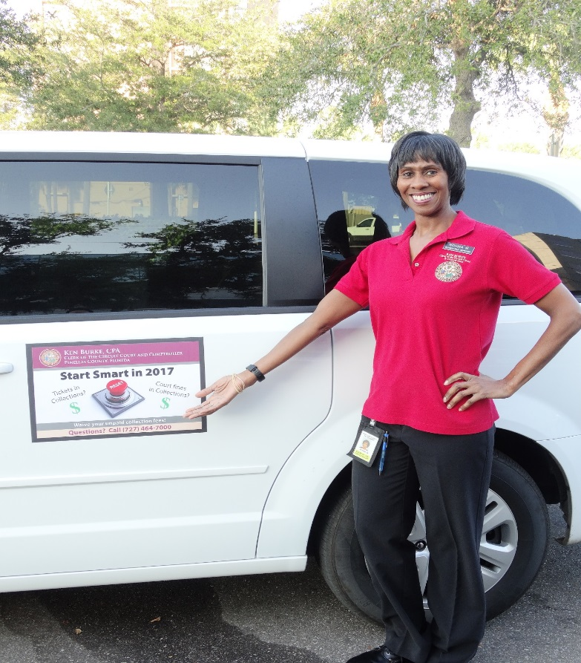
Promotion
To ensure that the public was receiving accurate information – self promotion was very important. We needed to reach out personally to as many organizations/media/individuals as possible.
Social media – Facebook, Twitter, Craigslist
General media – newspapers, local tv news stories (both before and during event)
Local community organizations – flyers were distributed to local major organizations
Signage – Posters were placed around local government offices & county vehicles
Flyers, buttons, posters, banners and magnetic signs
Material costs totaled $1,514.40

Slide 16
Developing the Strategy
Timeframe
The dates - We took into account that often the beginning of tax season, as people start to receive their refunds, people have the ability to pay off fines.
February 27, 2017 – March 10, 2017 (excluding weekends)
Hours
Our normal hours of work are 8:30 – 4:30 M-F. Would that be sufficient time for everyone who would want to participate to take advantage of the event?
We hold traffic night court Wednesdays and Thursdays each week. This court goes from 4pm – 7 pm. We decided to offer extended event hours those nights.
Due to the extended hours Wednesday and Thursday we chose not to offer weekend hours
Consistency
We held multiple meetings from the onset of planning through the conclusion of the event with all entities of the Clerks office to ensure everyone was on the same page from the start.
Included in the meetings were our branch offices, all customer service sections including call center as well as managers & directors from each division of the Clerks office.

Slide 17
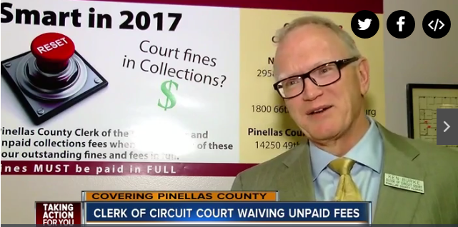
The Event
As the event started on
February 27th the media coverage of
the event also picked up. The news
stories, articles and press releases
were abundant and the citizens in the
county were responding. As we
opened the doors there were lines and the steady stream of customers never slowed.
We continued to hold our meetings to go over what was working for the event and what, if any, changes needed to be made for the remainder of the Start Smart campaign.

Slide 18
The Results
Our first day was our biggest success with $138,331.73 collected amongst our different Clerk locations
During this first day we waived $49,809.19 in collection fees
Overall, during the 10 day event, we collected $588,809.45!
Waiving a total of $211,995.77
A total of 1,145 individuals were assisted resolving 1,962 cases.
1,063 D6 clearances were
processed, 221 affidavits
provided and 119 licenses
reinstated

Slide 19
What did we learn?
Planning was the key to our success. Having set parameters around the event and clear communication between our various offices made a huge difference.
The impact of the media both online and televised got the word out early and let people prepare and save for the event.

Slide 20
Questions?

Slide 21
What is Possible? Challenge for Compliance Improvements
Stephanie Belden, Compliance Officer
Citrus County Clerk of the Circuit Court and Comptroller

Slide 22
Spring Into Savings Events
Citrus County Clerk of the Circuit Court and Comptroller

Slide 23
Event History
Started after the Operation Green Light campaign held statewide
Leap into Savings 2016
Fall into Savings 2016
Spring into Savings 2017

Slide 24
Event Dates
Selected last week of February – first week of March during Leap/Spring into Savings events
Fall into Savings was held the middle of October
Normal staffing with some extended hours

Slide 25
How We Got the Word Out
Letters to our stakeholder agencies
Press releases
Facebook notices
Flyers

Slide 26
How Successful We Were
Operation Green Light – 135 cases for $85,298
April 13 – April 18, 2015
Leap Into Savings – 243 cases for $142,035
February 29 – March 4, 2016
Fall Into Savings – 49 cases for $17,364
October 17 – October 21, 2016
Spring Into Savings – 185 cases for $95,810
February 27 – March 3, 2017

Slide 27
How It Effected Collections
Overall Submissions to Agencies
Overall Payments Made
Month | Linebarger | Linebarger Amount | MSB | MSB Amount | CJ/DP | CJ/DP Amount
Jan-17 | 166 | $135,597 | 443 | $146,504 | 250 | $47,106
Feb-17 | 59 | $32,457 | 88 | $40,901 | 184 | $24,571
Mar-17 | 188 | $138,098 | 179 | $95,805 | 424 | $48,505
Apr-17 | 126 | $77,506 | 147 | $122,987 | 1143 | $87,895
Month | Linebarger Amount | MSB Amount
Jan-17 | $12,074 | $14,674
Feb-17 | $16,920 | $17,639
Mar-17 | $18,798 | $25,056
Apr-17 | $17,583 | $25,419

Slide 28
What We’ve Learned
Saturday did not bring in added traffic
Fall event totals equal to one day of Spring event
Tax time worked best
Scheduled to overlap two months
No impact to payments before or after event

Slide 29
Questions?
Stephanie Belden
sbelden@clerk.citrus.fl.us
352-341-7081

Slide 30
What is Possible? Challenge for Compliance Improvements
Kristi M. Wagstaff, CPM
Collections Enforcement Manager
Polk County

Slide 31
Alternative Community Service
Hours must be completed at Non-Profit Organization (http://dos.myflorida.com/sunbiz/)

Slide 32
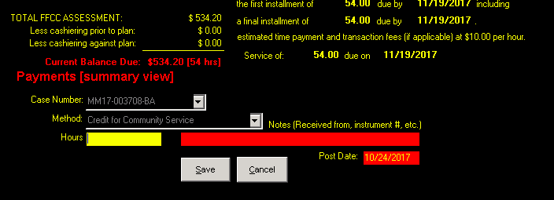
Automation

Slide 33
Do Defendants comply with ACS plan?
18,660 cases on ACS
12,569+ satisfied

Slide 34
Positives/Negatives/Issues
Good for the Community
Defendant may end up volunteering on their own afterwards
Defendant may learn tasks to add to their resume
Helps Collection Rate
Liability Insurance
Revenue
Verification of Hours
Possible “Double Dipping”
Approval of the Court

Slide 35
Questions?

Slide 36
Legislative Opportunities
The Honorable Tara S. Green, Clerk or Court, Clay County
Jason Harrell, Budget and Communications Director, CCOC

Slide 37
Mission Possible: Optimizing Compliance Tools

