Slide 1
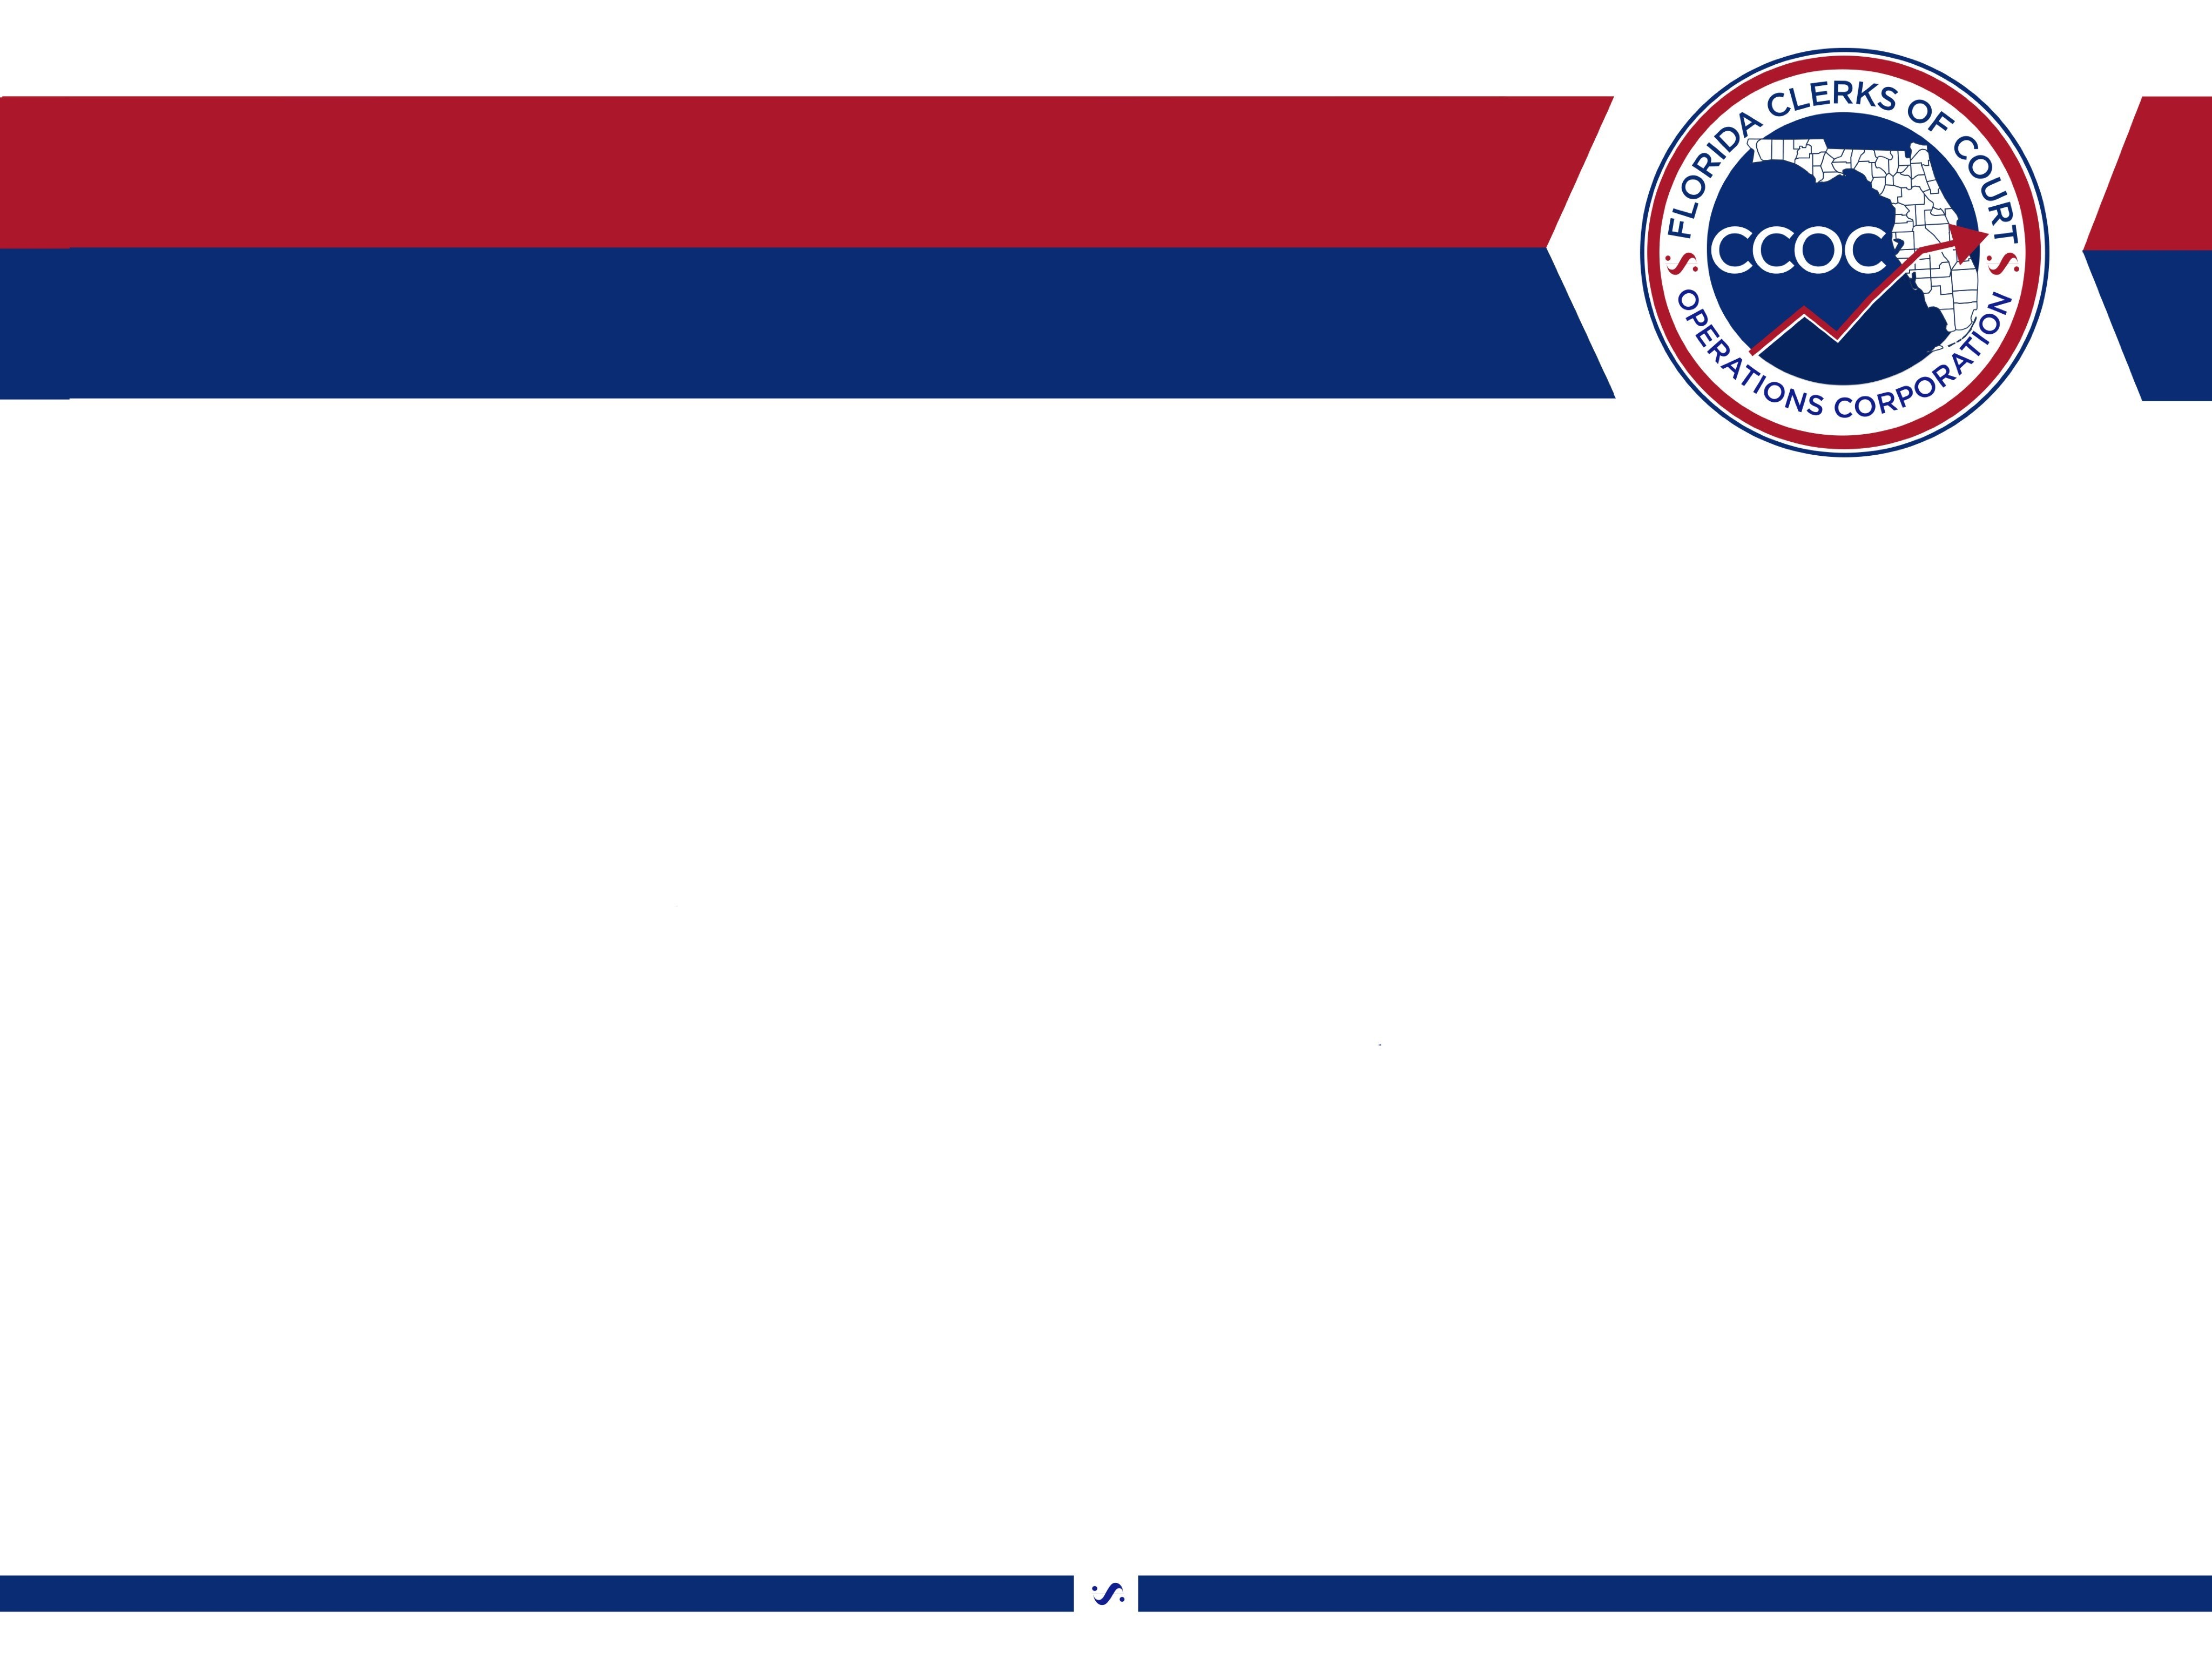
Mission Possible:
Optimizing Compliance Tools

Slide 2


Mission Possible:
Optimizing Compliance Tools

Slide 3
Resolving Common Court Compliance Issues
Louis Tomeo
Director of Criminal Court Services
Palm Beach County

Slide 4
Resolving Common Court Compliance Issues
Louis Tomeo
Director of Criminal Court Services
Palm Beach County

Slide 5
Court Collections Issues
Prior Issues
Actions Taken
1. Motions to modify cost order.
1. Worked with judiciary to develop order requiring defendant to establish payment plan.

Slide 6
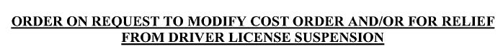
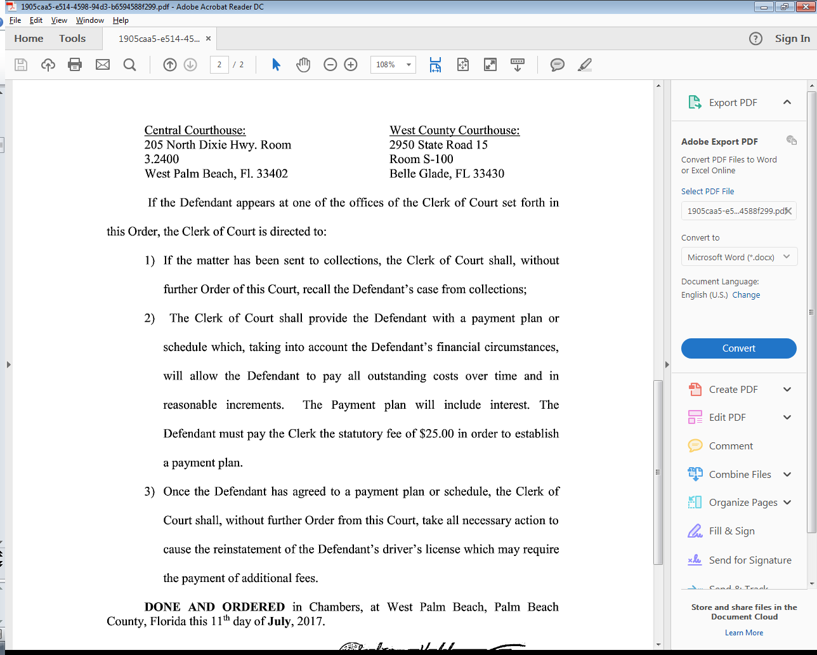
Example of Court Order

Slide 7
Court Collections Issues
Prior Issues
Actions Taken
1. Motions to modify cost order.
1. Worked with judiciary to develop order requiring defendant to establish payment plan.
2. Court not ordering payment plans.
2. Met with all Criminal Judges to demonstrate benefits of a payment plan vs. no payment plan. Discussed the correlation between successful completion of payment plans and DL suspensions.

Slide 8
Payment Plan vs. No Payment Plan
MM/CT cases only
CY 2013 - 2014: 20,449 cases
Payment Plan
# of cases |  | percentage
Total | 1,776 | 9%
Payment plan completed or making payments | 1,127 | 64% Success
DL suspended for failing to comply | 649 | 36% Suspended
No Payment Plan
# of cases |  | percentage
Total | 18,673 | 91%
Paid or making payments | 4,628 | 25% Success
DL suspended for failing to comply | 14,045 | 75% Suspended

Slide 9
Increase of Payment Plans
Notes:
Compare 2014 – 6,299 with 2016 -9,137

Slide 10
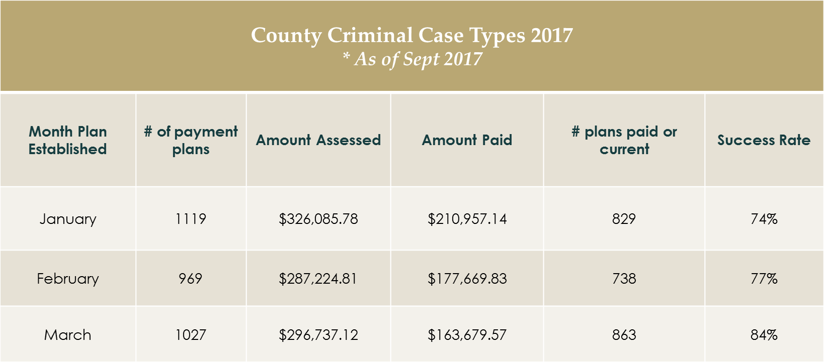
Payment Plan Aging Analysis

Slide 11
Court Collections Issues
Prior Issues
Actions Taken
1. Motions to modify cost order.
2. Court not ordering payment plans.
1. Worked with judiciary to develop order requiring defendant to establish payment plan.
2. Met with all Criminal Judges to demonstrate benefits of a payment plan vs. no payment plan. Discussed the correlation between successful completion of payment plans and DL suspensions.
3. Defendants who violate probation for failure to pay have assessment reduced to judgment.
3. Met with County Criminal Judges to explain unintended consequences of reducing assessment to judgment.

Slide 12

Misdemeanor
Probation Collection Issues
CY 2013 - 2014 | # of cases | Percentage
Probation cases with outstanding fees | 1089 | -
Successfully completed probation | 219 | 20%
Issued violation of probation for failure to pay and driver license/collection agency | 870 | 80%
Notes:
20% (219) cases successfully completed probation. No DL suspension or collection agency surcharge.

Slide 13
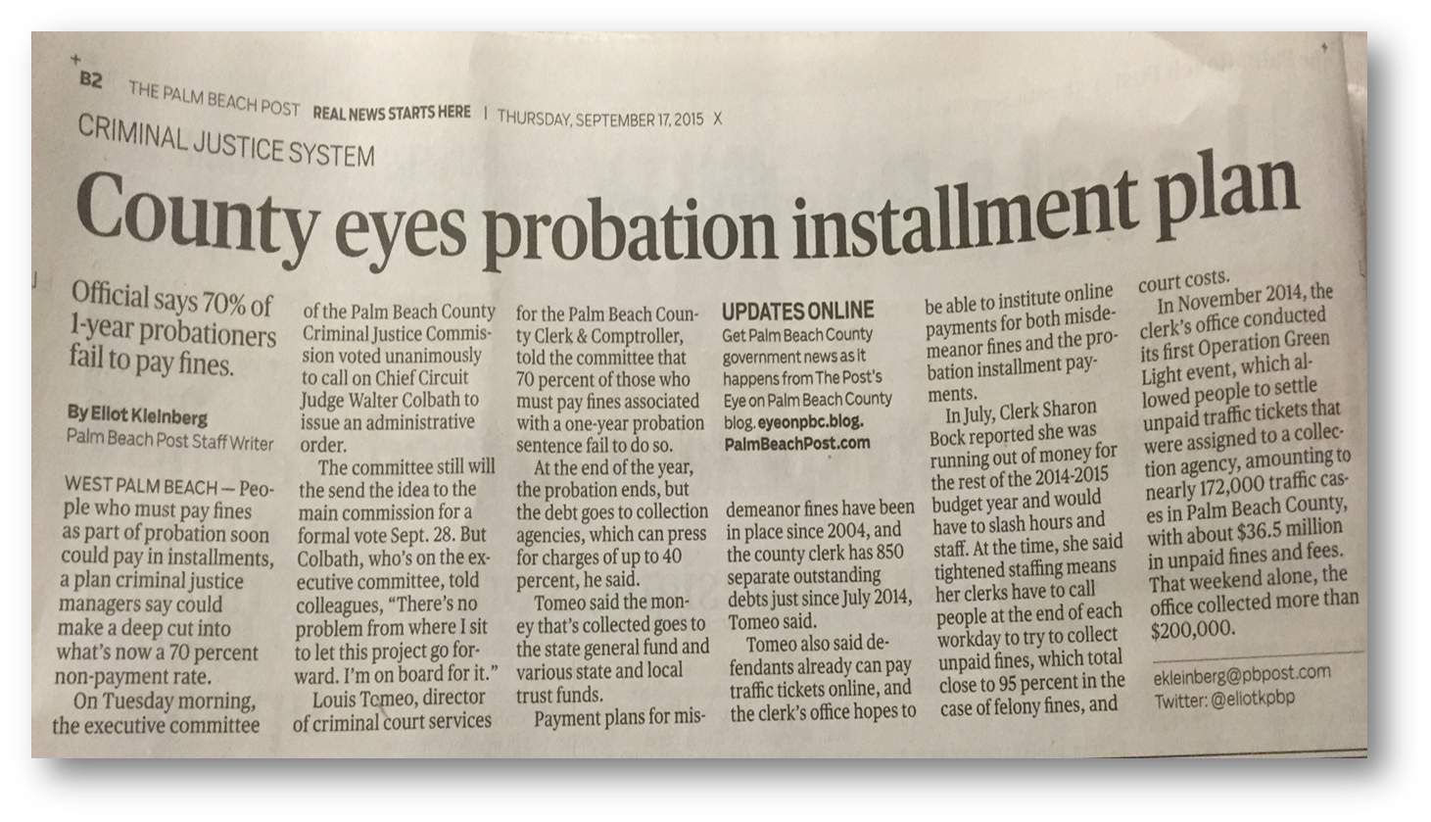
Palm Beach Post
September 17, 2015

Slide 14
Payment Plan vs. No Payment Plan
Probation
Implemented October 2015
FY October 2015 – Current: 2,772 cases
Payment Plan
# of cases |  | percentage
Total | 354 | 13%
Payment plan completed or making payments | 280 | 79% Success
Failed to establish or make payment on payment plan | 74 | 21%
No Payment Plan
# of cases |  | percentage
Total | 2418 | 87%
Payment plan completed or making payments | 940 | 39% Success
No payment | 1478 | 61%
Notes:
Collected $6,588.00 (14%). (UPDATED 3/27)
Phone Calls.
We work with the Probation Agency. If defendant cannot be reached by phone, we will contact local probation as a reminder for the probationer to pay.
We are seeing a few other judges begin to order defendants to establish payment plans while on probation.
We will readdress this issue with the Admin Judge when more data has been compiled.

Slide 15
Court Collections Issues
Prior Issues
Actions Taken
1. Worked with judiciary to develop order requiring defendant to establish payment plan.
2. Met with all Criminal Judges to demonstrate benefits of a payment plan vs. no payment plan. Discussed the correlation between successful completion of payment plans and DL suspensions.
1. Motions to modify cost order.
2. Court not ordering payment plans.
3. Defendants who violate probation for failure to pay have assessment reduced to judgment.
3. Met with County Criminal Judges to explain unintended consequences of reducing assessment to judgment.
4. Incorrect Assessment of Fines/Costs.
4. Clerks assumed the responsibility of preparing cost orders in January 2015. Automated through CMS.

Slide 16

Assessment Collection Report
Fines, Court Costs and Other Mandatory Penalties – Mandatory and Discretionary Amounts | FY 2014 | FY 2015 | FY 2016
Amount under-assessed if any | $ 1,806,633.15 | $ 765,707.20 | $ 292,566.86
Amount Collectible | $ 7,703,011.82 | $ 7,764,364.94 | $ 35,640,248.99
Percentage of under assessments compared to amount to be assessed | 17.86% | 8.73% | .76%
Total Collections | $ 2,038,937.72 | $ 3,173,266.35 | $ 2,684,544.32
Collection Rate | 25.13% | 34.82% | 7.22%

Slide 17
Court Collections Issues
Prior Issues
Actions Taken
1. Worked with judiciary to develop order requiring defendant to establish payment plan.
2. Met with all Criminal Judges to demonstrate benefits of a payment plan vs. no payment plan. Discussed the correlation between successful completion of payment plans and DL suspensions.
3. Met with County Criminal Judges to explain unintended consequences of reducing assessment to judgment.
4. Clerks assumed the responsibility of preparing cost orders in January 2015. Automated through CMS.
5. Payment plan offices available on the 9th and 4th floor.
1. Motions to modify cost order.
2. Court not ordering payment plans.
3. Defendants who violate probation for failure to pay have assessment reduced to judgment.
4. Incorrect Assessment of Fines/Costs
5. Defendants leaving court without establishing a payment plan.
Notes:
In the past, it has been the practice of the Court to not assess minimum mandatory fines/costs.
Fines/costs on the first charge and not on others.
PBC had one of the highest amount of under-assessments in the state per the AC report.
Implemented our In Court Processing System through our CMS vendor.
CMS enables Clerks to electronically assess all minimum/mandatory fines/costs per count as applicable.

Slide 18

Peel back the onion

Slide 19
Failure to Establish Plan
2016 – Misdemeanor Cases Only
Courtroom | Total Cases w OAC4 | Failed to establish | %
#1 Gun Club | 295 | 250 | 85%
#1 South Branch | 225 | 129 | 57%
#1 West Branch | 5 | 1 | 20%
#2 Gun Club | 194 | 128 | 66%
#2 North Branch | 58 | 34 | 59%
#2 West Branch | 4 | 0 | 0%
2C Main Branch | 41 | 34 | 83%
2E Main Branch | 148 | 101 | 68%
4D Main Branch | 78 | 64 | 82%
9B Main Branch | 96 | 66 | 69%
9E Main Branch | 58 | 14 | 24%
9F Main Branch | 4 | 3 | 75%
9G Main Branch | 29 | 9 | 31%
9H Main Branch | 90 | 64 | 71
Grand Total: | 1325 | 897 | 68%

Slide 20

Court Compliance Team
Payment Plan Office
Obtained cooperation from the court.
Established multiple payment plan offices.
Compliance Ambassador to assist and direct defendants.
Payment opportunities.
Notes:
Open Mondays and Fridays 8:30 a.m. - 1:00 p.m.

Slide 21
Payment Plan Office Stats
April – September 2017
Courtroom # | # cases ordered onto a PP | # cases PP was established | # cases Paid In Full | # cases failed to establish PP | Success
4D | 348 | 216 | 90 | 42 | 88%
9B | 247 | 164 | 48 | 35 | 86%
9G | 353 | 225 | 76 | 52 | 85%
9F | 298 | 221 | 55 | 22 | 93%
9H | 216 | 124 | 49 | 43 | 80%

Slide 22

Clerk Follow-Up
Missed Payment
1. Outbound phone calls are made.
2. Reminder letter mailed to defendant.
3. DMV notified of non-compliance.
Notes:
1,400 calls per month
350 calls per week

Slide 23
Court Collections Issues
Prior Issues
Actions Taken
1. Motions to modify cost order.
2. Court not ordering payment plans.
3. Defendants who violate probation for failure to pay have assessment reduced to judgment.
4. Incorrect Assessment of Fines/Costs
5. Defendants leaving court without establishing a payment plan.
6. Defendants failing to complete court ordered community service.
1. Worked with judiciary to develop order requiring defendant to establish payment plan.
2. Met with all Criminal Judges to demonstrate benefits of a payment plan vs. no payment plan. Discussed the correlation between successful completion of payment plans and DL suspensions.
3. Met with County Criminal Judges to explain unintended consequences of reducing assessment to judgment.
4. Clerks assumed the responsibility of preparing cost orders in January 2015. Automated through CMS.
5. Payment plan offices available on the 9th and 4th floor.
6. Reduce the amount of time to complete community service.
Notes:
In the past, it has been the practice of the Court to not assess minimum mandatory fines/costs.
Fines/costs on the first charge and not on others.
PBC had one of the highest amount of under-assessments in the state per the AC report.
Implemented our In Court Processing System through our CMS vendor.
CMS enables Clerks to electronically assess all minimum/mandatory fines/costs per count as applicable.

Slide 24
Failure to Perform Community Service in Lieu of Fines/Costs Outcome
2016
Status | MM | Percentage
Failed | 721 | 82%
Success | 67 | 8%
Paid in full | 64 | 7%
Partial C/S & Partial Payment | 26 | 3%
Still have time to complete C/S | 4 | < 1%
Total: | 882
Notes:
Number of defendants ordered 882
Average time frame (in days) 365
Average Amount Assessed $449.77
$37.50 per month
4 hours of community service hours per month
1 hour of community service per week

Slide 25
Failure to Perform Community Service in Lieu of Fines/Costs
Case scenario
Average time frame | 365 days
Average amount assessed | $ 449.77
Breakdown
Monetary payment per month | $ 37.40
Community service hours per month | 4 hours
Community service per week | 1 hour

Slide 26
Community Service Plan
When ordering community service, have defendant establish payment plan with clerk.
Defendant is to either submit community service hours completed or monetary payment monthly, until plan is completed.
Failure to either submit community service hours or monetary payment as scheduled will result in financial suspension of driver license.
Notes:
DO WE WANT A SCREENSHOT OF THE DRAFT COMMUNITY SERVICE ORDER????

Slide 27

Questions?

Slide 28
In-House Compliance Programs
The Honorable Judge Robert Hilliard, 1st Judicial Circuit
The Honorable Don Spencer, Clerk of Court, Santa Rosa County
John Venable, Chief of Staff, Santa Rosa County
Kristi Wagstaff, Collections Enforcement Manager, Polk County

Slide 29
The Honorable Judge Robert Hilliard
1st Judicial Circuit

Slide 30
SANTA ROSA CLERK OF COURTS
The Honorable Don Spencer, Clerk of Court
John Venable, Chief of Staff

Slide 31
SANTA ROSA CLERK OF COURTS
COURTHOUSE COLLECTIONS

Slide 32
Purpose:
To assist customers in remaining compliant with payment of Fines and Court cost helping to maintain their license and reducing potential reoffending.
To increase Clerk revenue and move to a position of self sustaining funding.

Slide 33
Resources needed:
Minimum of 2 persons
Lexis-Nexus
Robo Call system
Mail out reminder cards
Partial Payment Form
Develop an identifier that is placed in the file in CMS to track collections. It can be used to generate reports. (CHCL in compliance field).
Tracking code examples: CD partial pay, CD action

Slide 34
Buy In:
Judicial buy in is essential!
  It frees up dockets and promotes judicial economy.
  Judge informs them of their options.
What we ask Judges to say.
  “Your Fines and Fees are due in full today. Please go to the Clerk’s office before leaving the Courthouse and either pay your fees in full or sign up for the Clerk’s partial payment plan.”
  If defendant is incarcerated, “Your fines and fees are due within 90 days of your release from incarceration. Go to the Clerk’s office within that 90 days of release and either pay your fines and fees in full or sign up for the Clerk’s partial payment plan. If you fail to report to Clerk’s office within 90 days of release a judgement will issue.”

Slide 35
Buy In:
They are directed to go to Clerks office with their minutes that day immediately after court.
They are given their minutes in a blue folder to identify them.
Court Security knows to look for people with those blue folders. They help direct the defendant to the Clerk’s office.
Probation works w/ Clerks office to ensure payment of fines and fees.

Slide 36
Process: Partial Payment Form
Develop a PPP Form to include personal Info.
  Obtain customer contact info:
    Email
    Cell Phone
    Home Phone
    Work Phone & Employer
    Mailing address
    Personal Reference
  Anything that will help contact that individual later.

Slide 38
Process: Partial Payment Form
Customize payment options and explain consequences.
  Acceptable forms of payment.
    Credit card, cash, money order, personal checks, etc.
    Keep customers information secure and safe.
  Set up fee of $25.00 (Clerk may offer to spread out over time)
  Due date of payment(10th, 20th or 30th)
  Balance Due.
  Explanation of loss of driving privilege and other consequence of failure to pay.
  Place for parties to sign.

Slide 40
Customer Service:
Maintain a positive and courteous philosophy.
When making a payment in person, confirm customers contact information against form and CMS.
To assist customer and Clerk, pull cases back from collection agency, if there has not been any payments to agency.
Customers are allowed 2x to complete PPP, then send to collections agency. Must be paid in full then to reinstate license.

Slide 41
Failure to Pay:
Process notification cards, informing of license suspension if they do not contact Clerk for delinquent fines and fees.
Emphasize to them to let Clerk know if there is a problem.
  Flexibility is key to success.
  Work with customer on missed payment as long as it is not a regular request.
  Fosters a relationship with the customer/defendant that keeps them engaged.

Slide 42
Failure to pay: Reminder Card

Slide 43
Failure to Pay:
Utilize a Robo call system to remind customer of payments and potential loss of license.
Example:
  “Hello, this is Don Spencer, Santa Rosa County Clerk of Court reminding you to make your payment this month. Remember, if you fail to make your payment your driver’s license will be suspended and your balance will be sent to our collection agency which charges a 40% fee on top of the balance due. If you have already made this months payment, I wan to thank you and please disregard this message. Again, this is Don Spencer, SRC Clerk of Court reminding you to make your payment this month. Remember, if you fail to make your payment your drivers license will be suspended and your balance will be sent to collections which charges a 40% fee on top of the balance due. If you have already made this month’s payment, I want to thank you, and please disregard this message.”

Slide 44
Failure to Pay:
Contact customer/defendant that has failed to make a payment.
  Phone
    “Hello this is Don Spencer Santa Rosa County Clerk of Court advising you that we failed to receive your monthly installment payment. Please contact our Collection Department at 850-981-5655 within the next 3 working days. Failure to do so will result in your drivers license being suspended and your case being sent to our collection agency which charges an additional 40% collection fee. Again this is Don Spencer Santa Rosa County Clerk of Court advising you that we failed to receive your monthly installment payment. Please contact our Collection Department at 850-981-5655 within the next 3 working days. Failure to do so will result in your drivers license being suspended and your case being sent to our collection agency which charges an additional 40% collection fee.

Slide 45
Failure to Pay:
  Email & Text Messaging
    “This is Don Spencer Santa Rosa County Clerk of Court advising you that we failed to receive your monthly installment payment. Please contact our Collection Department at 850-981-5655 within the next 3 working days. Failure to do so will result in your drivers license being suspended and your case being sent to our collection agency which charges an additional 40% collection fee.”

Slide 46
Termination:
Once customer has cleared their fines and fees, destroy their CC and/or Banking info.
Send them a letter of completion
If additional cases are pending or remaining, continue with next case on payment plan.
If customer fails PPP 2x’s, refer to outside collections agency.
Notify customer if that happens, they will have to satisfy completely to regain license.

Slide 47
Success!

Slide 48
Remember:
It is a marathon, not a sprint!
Results will start slowly, but build over time.
But within a reasonable time, you will see the difference your own Collections Unit will make in your office.

Slide 49
CHCL Collections Report

Slide 50

Results:

Slide 51
Stacy M. Butterfield, CPA
Polk County Clerk of Courts and County Comptroller
Kristi M. Wagstaff, CPM
Collections Enforcement Manager

Slide 52
Points of Interest
“Purple Folder” County
Main Courthouse plus two branch locations
Criminal Traffic, Misdemeanor, Felony
Application with telephone numbers verified
Average of 50 interviews per day
Automation of payment plans, letters, phone calls
Alternative Community Service Plan for indigent

Slide 53
Quality Staff
Professional
Persuasion and Negotiation Skills
Communication Skills
Organizational Skills
Ability to multi-task
Previous Collections Experience

Slide 54
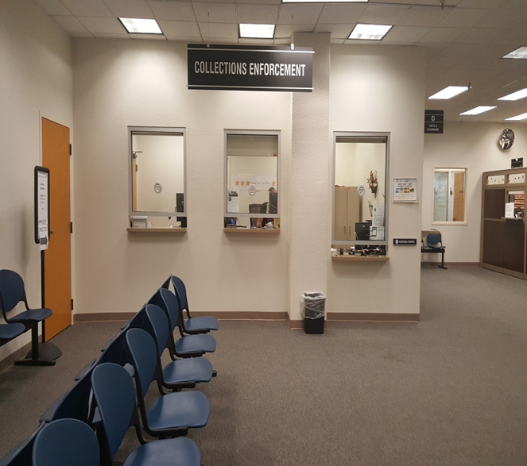
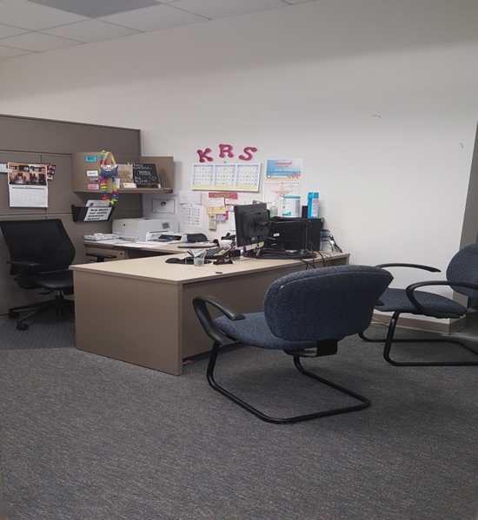

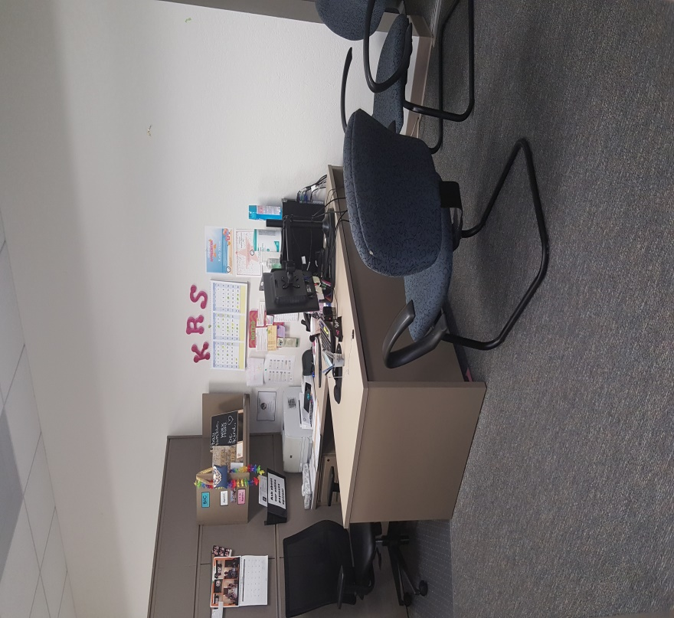
Department Visuals
Lobby with Cashier/Intake Windows
Compliance Officer Workstation

Slide 56
Felony Collections
In 2011 we piloted a successful program to enhance the felony collection rate. At that time, the felony collection rate was approximately 6%. Results were seen immediately. For RPE 9/30/11, the overall felony collection rate was 17.35%.
F/CC continue to be a condition of Probation for Felony cases. However, we are collecting on a monthly basis, as opposed to when DOC was handling the financials and just having the offender pay prior to the end of the probation period (which was usually well outside our reporting period).

Slide 57
County Probation Cases
In May 2017, the Clerk’s Office started handling the financials for cases sentenced to County Probation. Fines/costs are no longer a condition of Probation.
If Defendant fails to comply with payment plan, DL suspension becomes effective, regardless of whether they are still on probation.

Slide 58
Statistics
159,194 payment plans processed through Collections Enforcement since department inception on August 8, 2005
$81,107,229 assessed; $50,677,198 collected (63%)
Of those on active payment plans, approximately 80% are paying on time.

Slide 59
Collections
$29,198,034 Assessed
$13,175,980 Collected
47%
$51,909,195 Assessed
$37,501,218 Collected
73%

Slide 60
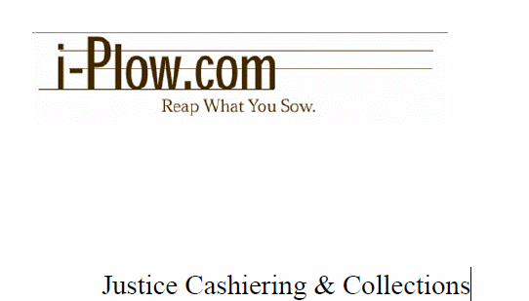
Polk County Collections Enforcement

Slide 61
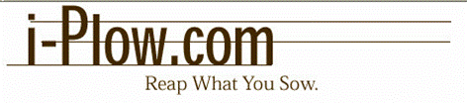
Polk County i-Plow
Scrutinization – Fully Automated
Establish Payment Plans and Community Service Plans
Automated Phone Calls/Letters
Due Diligence Events and Reminders
Various Staff Performance Reports
Various Case Activity/Status Reports
Various Overall Compliance/Collections Reports
i-Plow’s design concept is like play dough, malleable enough to be molded to fit your local requirements. You define how it works. It is also fully configurable to the court level.

Slide 62
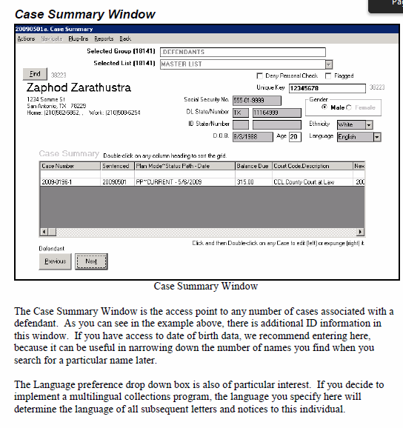
Case Detail Window

Slide 63
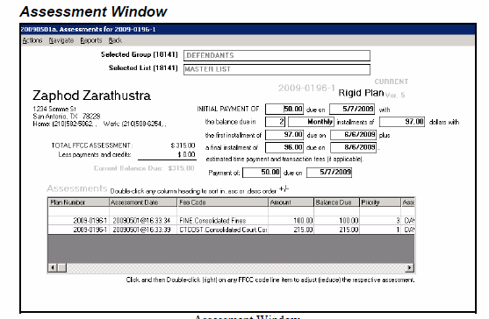
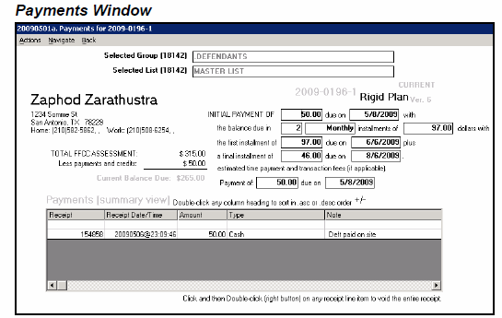
Assessment Window/Payment Window

Slide 64
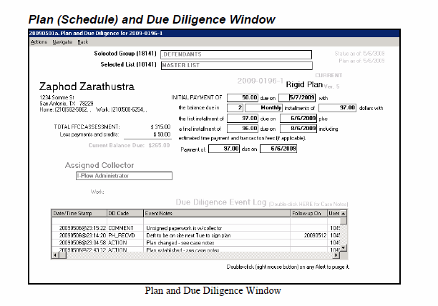
Plan and Due Diligence Window

Slide 65
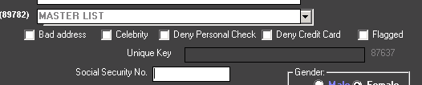
Flag by Defendant

Slide 66
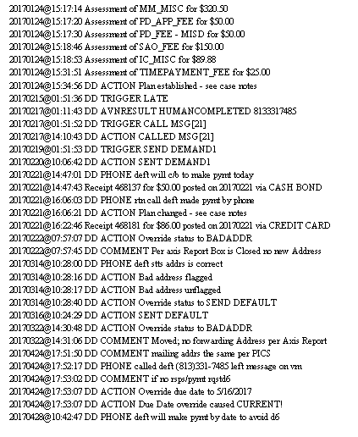
Collections Case Assessment and Receipt Activity

Slide 67
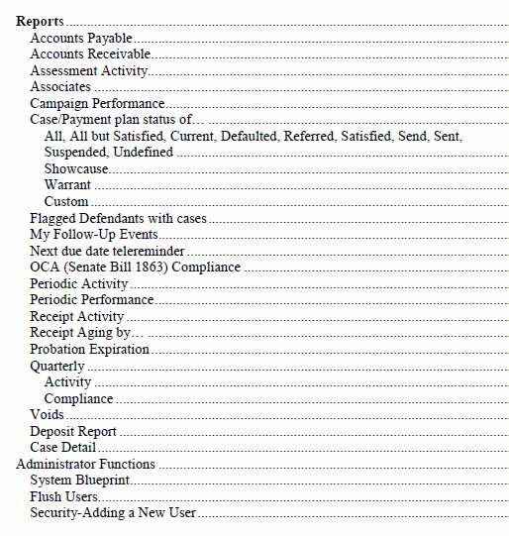
Reports

Slide 68
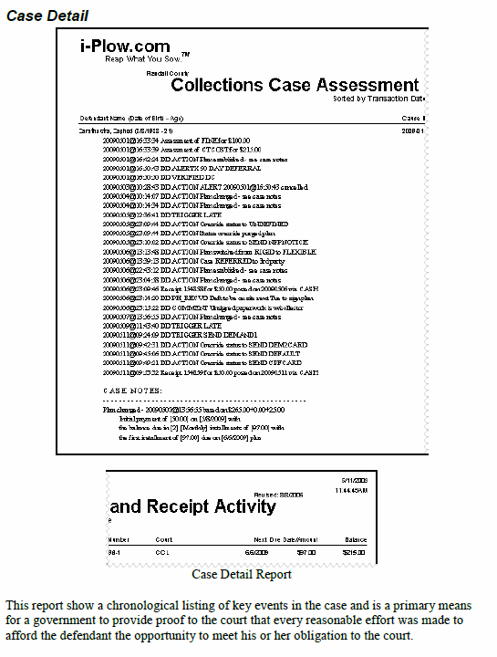

Slide 69
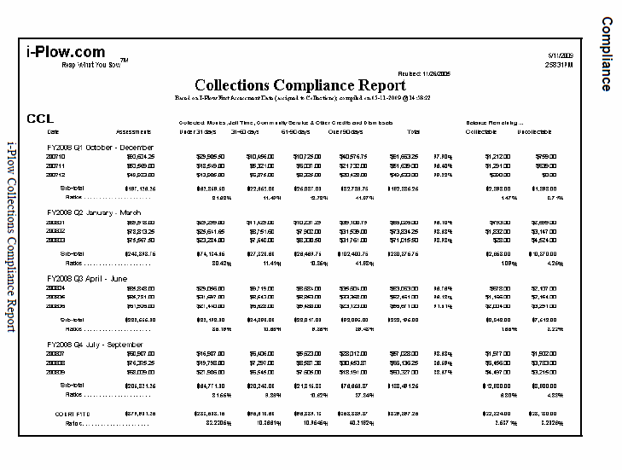

Slide 70
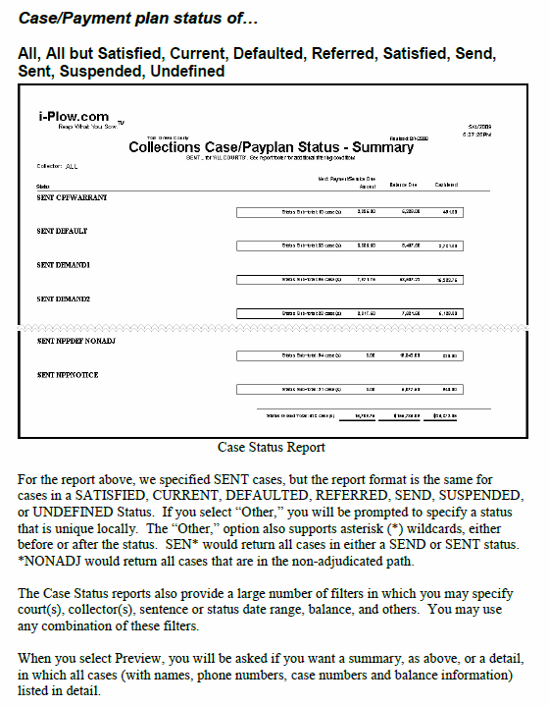

Slide 71
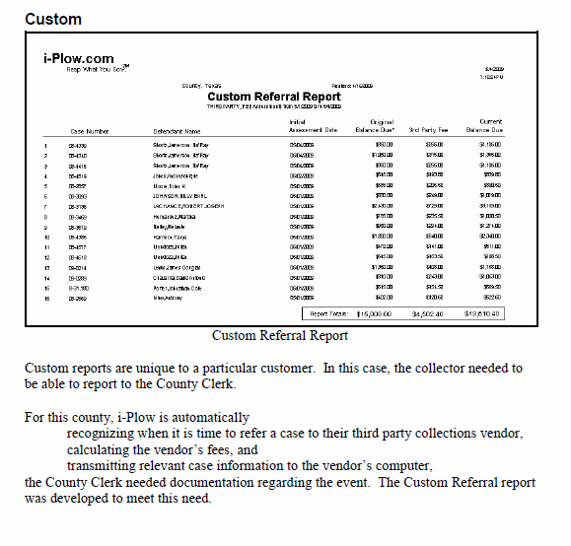

Slide 72
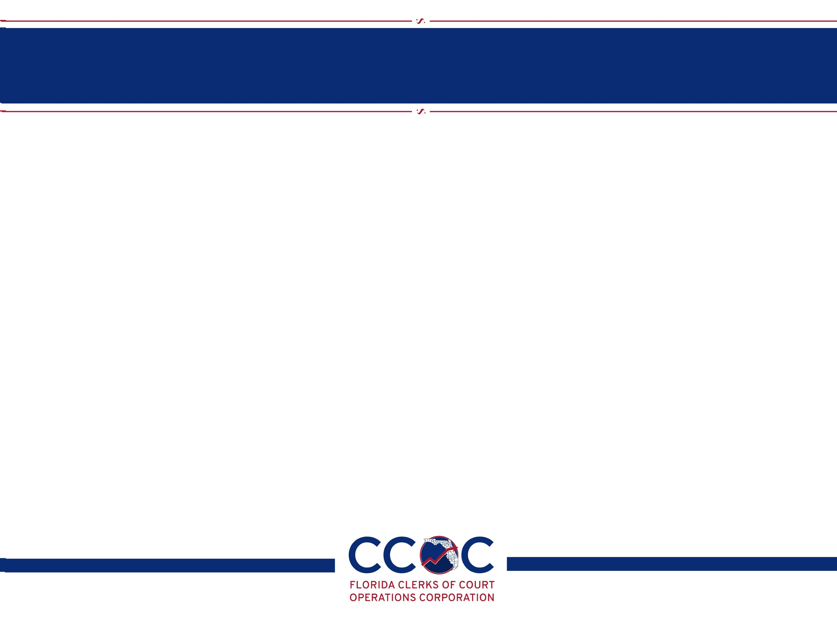
i-Plow Contact
If interested, contact Mark W. Odom at 210-582-5803 or mwodom@i-plow.com

Slide 73
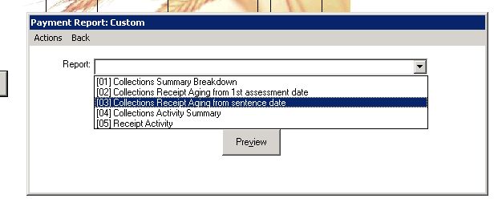
Accountability Reports
  Custom Reports

Slide 74
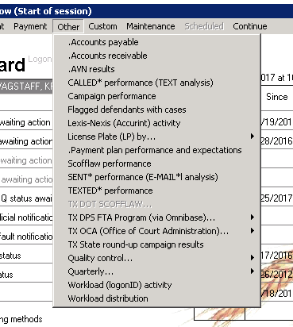

Slide 75
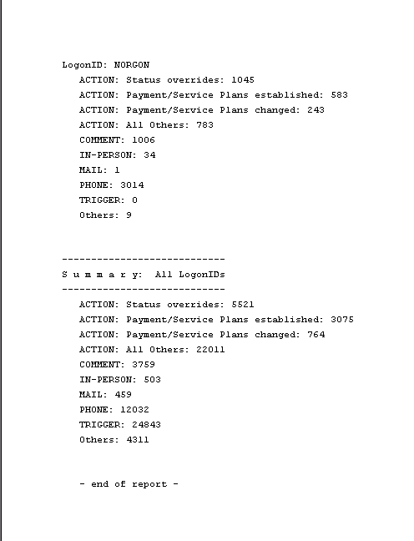
Workload (loginID) Activity

Slide 76
Questions?
Kristi M. Wagstaff, CPM
Collections Enforcement Manager
kristiwagstaff@polk-county.net
863.534.4422
H. Lyle Bulman, CPM
Criminal Division Director
lylebulman@polk-county.net
863.534.7734

Slide 77
Mission Possible:
Optimizing Compliance Tools

Slide 78
Automating the Payment Process
The Honorable JD Peacock, Clerk of Court, Okaloosa County
Jennifer Spinelli, Deputy Chief Financial Officer, Duval County
Sheri Pristupa, Senior Manager, Duval County
Kristi Wagstaff, Collections Enforcement Manager, Polk County
Stephanie Belden, Compliance Officer, Citrus County

Slide 79
Okaloosa County nCourt Payment Solutions
JD Peacock, Clerk of Court
Okaloosa County

Slide 80
Okaloosa County nCourt Payment Solutions
  System Integration & Innovative Solutions
  Metrics
  Cases
  Customer Satisfaction

Slide 81
System Integration & Innovative Solutions
  Automated Payment File Process
    Automatically updates Case Management System
  Incoming call diversion to nCourt for Traffic Ticket calls
    Customer selects traffic ticket from our incoming phone tree system and gets transferred to nCourt Call Center
  Payment Plan customer notifications from nCourt via text message
    Automated payment reminders, then pay right from phone via link in text message.

Slide 82
System Integration & Innovative Solutions
  Un-banked customers ability to pay at local retail outlets
    CVS, Dollar General and expanding.
  “Cashless” Cash Bonds
    nCourt taking credit card payments for Bonds

Slide 83
Metrics
  Payments Excepted for all Traffic & Misdemeanor cases
  nCourt Payments
    2015 Total: 7,015
    2016 Total: 6,385
    2017 YTD: 5214
  2017 Customer Satisfaction Survey 8.57 out of 10.

Slide 84
Questions?

Slide 85
E-Payments
Jennifer Spinelli, Deputy Chief Financial Officer
Sheri Pritupa, Senior Manager
Duval County

Slide 86
E-PAYMENTS
  Integrated Payment Solution
  Case Types
  Results
  Next steps

Slide 87
Integrated Payment Solution
An open API allows for real-time posting of payments.
Reduce the number of revisions.
  Late fees
  D6 fees
Payments can be made at any time.
Customers see the payment on their case.
Allows for a seamless transition between credit card vendors.
  Current Rate is 2.75% vs. 3.5% for our prior vendor.

Slide 88
Case Types
Current eligible e-payments
  New civil citations less than 90 days old
    Excluding Proof of Compliance or Court Mandatory cases
  Late Fees
  TR Court Costs not referred to Collections
  Pre-established Payment Plans

Slide 89
Results

Slide 90
Next Steps
Available E-Payments by first Quarter of 2018
  Criminal Court cost (MM, MO, CT, and CF case types)
    Excluding cases where fees are a condition of probation
  Payable before Disposition
    Drug Test Fee
    PD Application Fee
  Criminal Court Cost pre-established payment plans
  Criminal Court cost Partial Payments
Future Enhancements
  Payment reminders via email and text

Slide 91
Questions?

Slide 92
Polk County Online Payments
Kristi M. Wagstaff, CPM
Collections Enforcement Manager

Slide 93
Polk County
CiviTek
Through MyFloridaCounty
Payments in full or partial payments for all case types
3.5% fee to customers
Report sent to Finance for posting
Future Enhancements

Slide 94
ACH Automatic Withholding Program
Stephanie Belden, Compliance Officer
Citrus County

Slide 95

What is ACH Automatic Withholding
Automatic withdraw monthly specified payments for payment plans
Offered to anyone signing up or already enrolled on a payment plan

Slide 96
Program Statistics
Began May 20, 2010 with 4 payments for $205.00
Currently 70 cases totaling over $5,300.00
319 cases have been paid off through ACH
42 requested removals
233 returns from the bank
  49 NSF
  184 Renegotiated Plan Returns

Slide 97
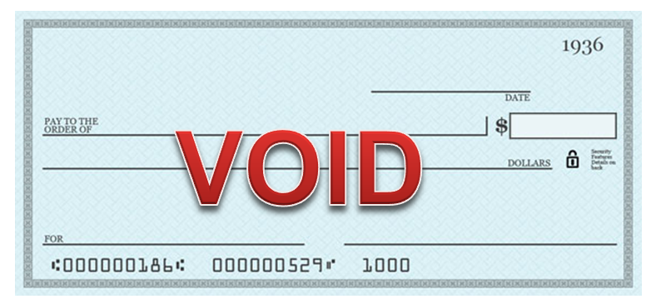
How It Works
ACH authorization form with voided check or letter from the bank
Selection of dates
Payments continue each month until case is paid in full

Slide 98
Benefits to Customers and Clerk’s Office
Reduction in foot traffic
  Increased efficiency for mail distribution and internal controls
Consistent payments
Stopped once case is paid in full
Manual receipting time lowered

Slide 99
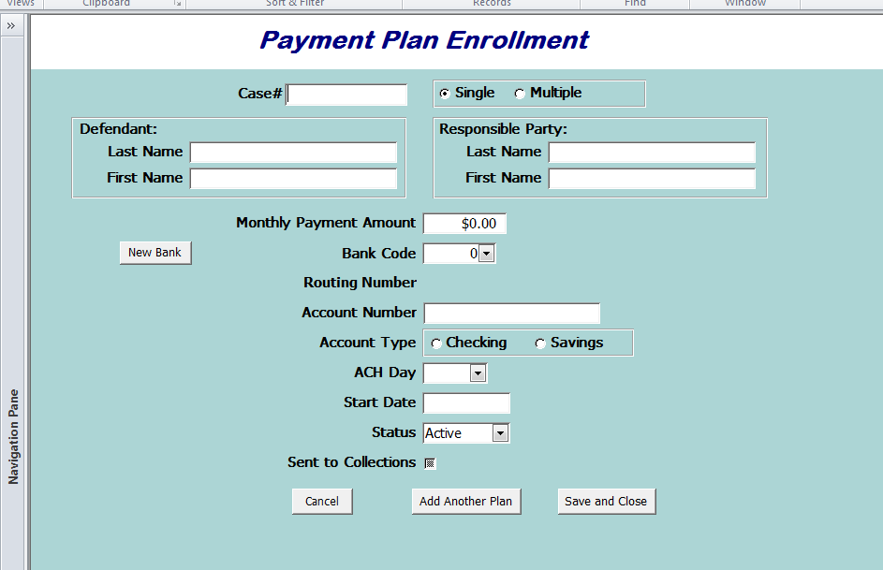
Our Process to Prepare for Payments
Established cut off date for changes/enrollments
Information entered into a Microsoft Access database

Slide 100
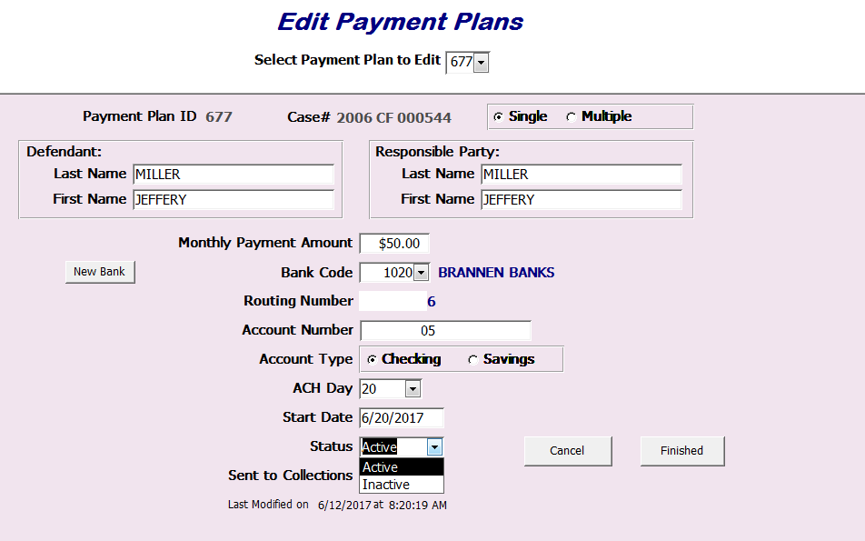
Our Process to Prepare for Payments
Data is reviewed. File is submitted to Finance to be sent to bank.

Slide 101
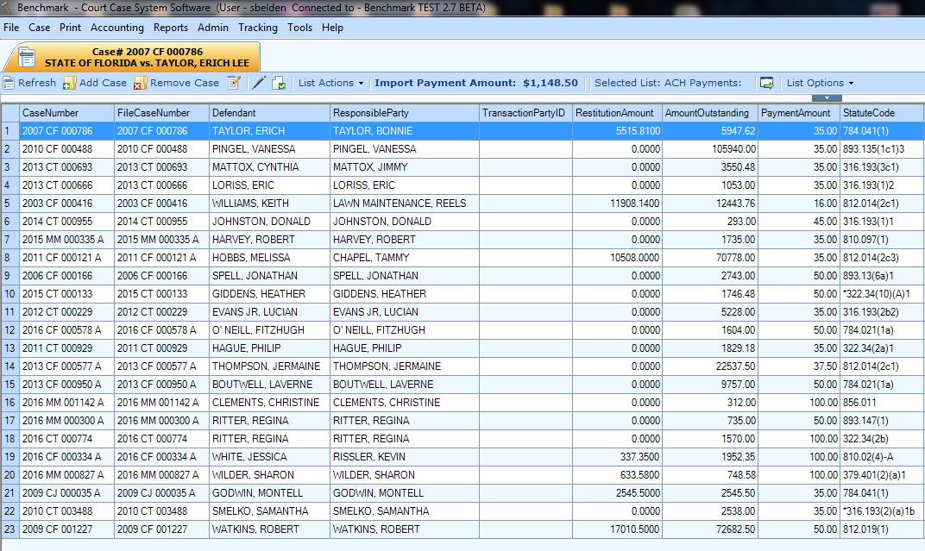
How Are Payments Receipted
Payments are loaded into court management system, reviewed and processed

Slide 102
Questions?
Stephanie Belden
sbelden@clerk.citrus.fl.us
352-341-7081

Slide 103
Mission Possible:
Optimizing Compliance Tools

