Slide 1
Mission Possible: Optimizing Compliance Tools

Slide 2
Mission Possible: Optimizing Compliance Tools

Slide 3
Tuesday, November 7
9:00 a.m. – 9:15 a.m. Welcome
9:15 a.m. – 10:30 a.m. Recent Trends in the Nationwide Court Compliance Process
10:30 a.m. – 10:45 a.m. Break
10:45 a.m. – 12:00 p.m. Blueprint to Compliance Improvement
12:00 p.m. – 1:00 p.m. Lunch
1:00 p.m. – 2:15 p.m. Resolving Common Court Compliance Issues
2:15 p.m. – 3:45 p.m. In-House Compliance Programs
3:45 p.m. – 5:00 p.m. Automating the Payment Process

Slide 4
Mission Possible: Optimizing Compliance Tools

Slide 5
Mission Possible: Optimizing Compliance Tools
Welcome!
The Honorable Tara Green, Clerk of Court
Clay County

Slide 6
Mission Possible: Optimizing Compliance Tools

Slide 7
Mission Possible: Optimizing Compliance Tools

Slide 8
Blueprint to Compliance Improvement
Don Murphy, Chief Officer of Courts
Lee County Clerk of Court

Slide 9
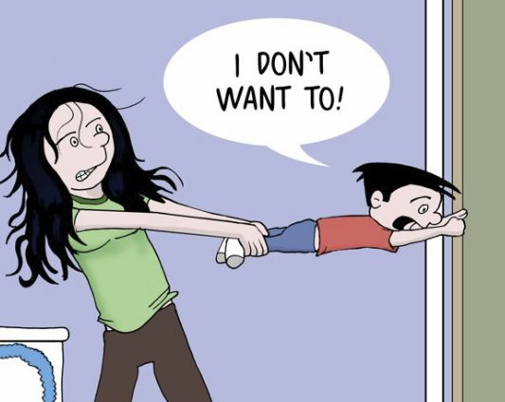
Why Collect?
REQUIRED CLERK STATUTORY DUTY
Florida Statute 928.30 (9) The clerk of the court shall enforce, satisfy, compromise, settle, subordinate, release, or otherwise dispose of any debts or liens imposed and collected under this section in the same manner as prescribed in s. 938.29(3).
ENFORCEMENT OF COURT ORDERED SANCTION Facilitates compliance with judicial orders
PROVIDES CLERK REVENUE OPPORTUNITY
2015/16- Statewide County Criminal
Total Assessed $ 189,288,807
Total Collections $ 130,330,485
1% increase in Collections $ 1.3 million dollars

Slide 10
STEPS TO BETTER COLLECTIONS
Understand Goals - Admin Support
Build Team with Right Skills
Gather Tools
Day 1 Payment Expectations
Notify, Notify, Notify
Track Performance

Slide 11
How? Communicate with all
Communicate with all parties involved in collections
Work with the judiciary
Immediately see Clerk after sentencing

Slide 12
How? Create Flexible Plans - Modify as needed
Create flexible payment plans
MOVE QUICKLY
ABILITY TO PAY
Modify individual payment plans

Slide 13
Competing directives - Payment Plans
MOVE QUICKLY
Clerks should understand the direct correlation between the effectiveness of collections and the amount of time that passes after imposition of Court costs and fines. Failure to move quickly to collect or enroll the Defendant in a payment plan will decrease the likelihood of collections significantly.

Slide 14
Competing directives - Payment Plans
ABILITY TO PAY- FL Statute 28.246 (4)
…..A monthly payment amount, calculated based upon all fees and all anticipated costs, is presumed to correspond to the person’s ability to pay if the amount does not exceed 2 percent of the person’s annual net income, as defined in s. 27.52(1), divided by 12. The court may review the reasonableness of the payment plan.
ACLU vs. Marion County
November 2, 2015

Slide 15
How? Use all Enforcement Tools
Use Tools that Fit for You
Notify- Postcards, Letters, Text Messages
About to be late, late, and off to collections agent
Phone Reminders
IVR (interactive voice response)
Outbound Call Process with staff
Recording Judgments in Official Records
Use Address Verification Software
Lexus/Nexus
Jail VINE Network
Cash Payment Service
PayNearMe
The Money Store
ACH Enrollment for Automatic Payments

Slide 16
How? Use Collections Firms & Negotiate
Send Cases to Collection Firms
Compromise Amounts Owed

Slide 17
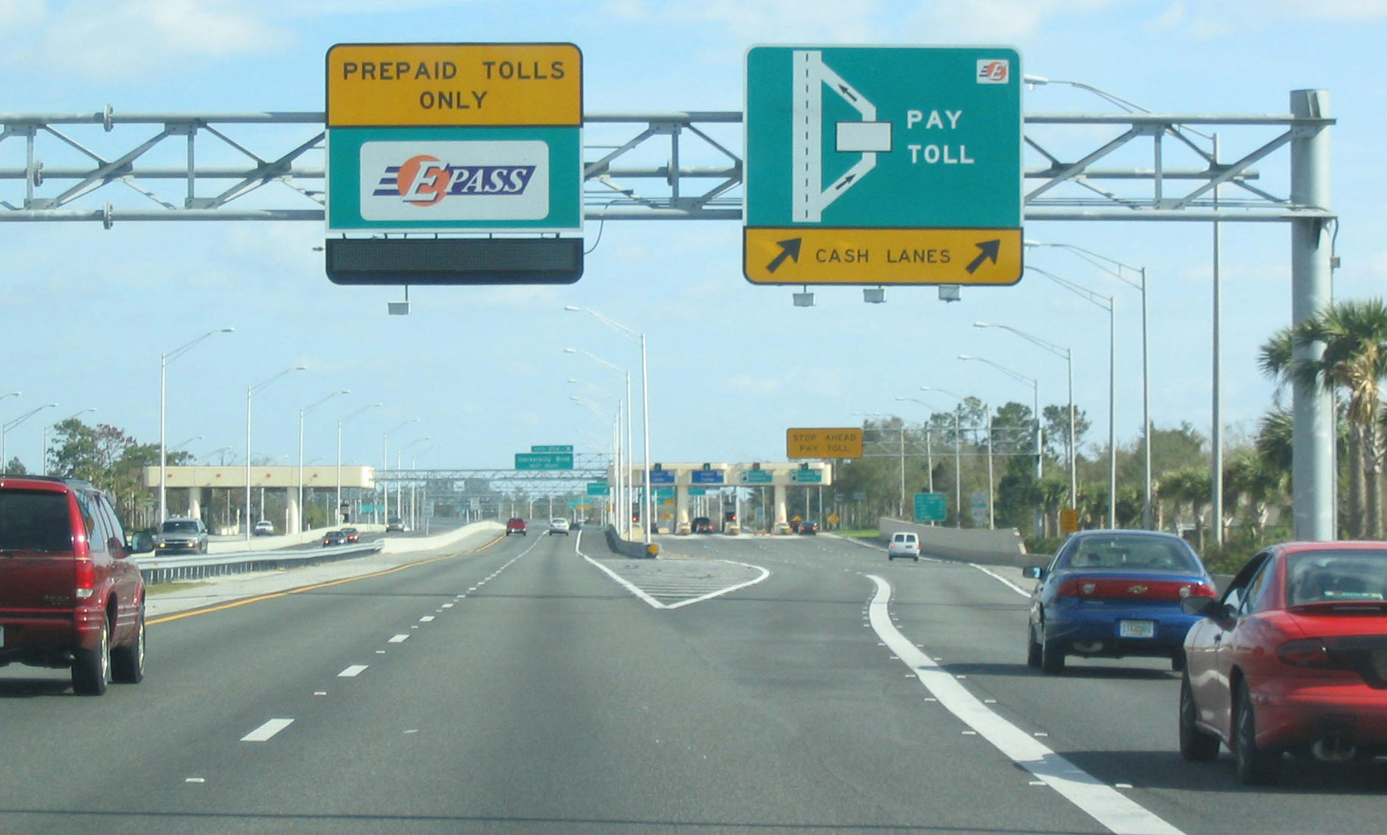
Toll Violations in Lee County
In 2016 over 21% of all payment plans were toll violations totaling $886,000 in costs for 2850 cases.
To date $438,915 is still owed just over half of the originating toll case costs due.
October 11, 2017-74 toll cases came into the system for Jane Doe to enroll in payment plans.
As a result of the Clerk’s ability to negotiate as authorized under FS 938.30,“The Clerk of Court shall enforce, satisfy, compromise, settle…..”
And further authorized locally by an administrative order which allows costs to be reduced to $50 per violation through Administrative Order the cost due was reduced from
$12,520 owed to $6,347 in payment increments of $200 per month
Notes:
2010 census- 618,754 residents

Slide 18
Primary Goal - Compliance
Limited ability to pay over time
Conversion available to perform service hours for payment due
Qualified Providers Available – Meets Community Need

Slide 19
How? Track & Measure Achievements
Use Accounts Receivable Program
Continuously evaluate goals & measure achievements

Slide 20
Getting Started - Not Alone
We all started somewhere
And we are never finished
Use Best Practices & tools

Slide 21
You Have Friends to Help!
Orange
clay
Duval
Pinellas
Polk
Lee
Santa Rosa
Citrus
Palm Beach
Seminole
Okaloosa
Brevard
Collection Summit Panelists

Slide 22
Thank you!
Don Murphy
Chief Officer of Courts
Lee County Clerk of the Court
dmurphy@leeclerk.org
239-533-2633

Slide 23
Questions?

Slide 24
Mission Possible: Optimizing Compliance Tools
Lunch

Slide 25
Mission Possible: Optimizing Compliance Tools

